Slide 1
Exercise Planning

Slide 2
Why do we exercise?
Exercises help build preparedness for threats and hazards by providing a low-risk, cost- effective environment to:
Test and validate plans, policies, procedures, and capabilities
Identify resource capability gaps, areas for improvement, and potential best practices
* Information from the National Exercise Program (NEP)

Slide 3
Types of exercises
Discussion-Based Exercises
Operations-Based Exercises
Focus on strategic, policy-oriented issues, and utilizes a facilitator(s) or presenter(s) to lead the discussion
Used to familiarize players with or to develop new plans, policies, procedures, or agreements
Facilitator Guide/EEG will be questions asked to gather participants responses
Examples:
  Seminar
  Workshop (WS)
  Tabletop (TTX)
Include a real-time response such as initiating roles and responsibilities; and identify resource gaps
Used to validate plans, policies, procedures, or agreements
MSEL/EEG will be action oriented injects to prompt a players response
Examples:
  Drills
  Functional Exercise (FE)
  Full-Scale Exercise (FSE)

Slide 4
Progressive Exercise Planning Approach
Use a variety of exercises aligned to program priorities and objectives
Increase the level of complexity over time
Does not always imply a linear progression of exercise types
*Information taken from FEMA HSEEP Course

Slide 5
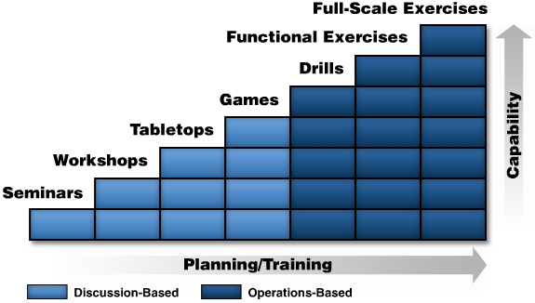
Building Block Approach to Exercise

Slide 6
Planning Meeting timeline
Concept & Objective Meeting (C&O)
  Conducted 5-7 months before the exercise
Initial Planning Meeting (IPM)
  Conducted 5-7 months before the exercise
Midterm Planning Meeting (MPM)
  Conducted 3 months before the exercise
MSEL Meeting (Optional)
  Conducted 3 months before the exercise
Final Planning Meeting (FPM)
  Conducted 4-6 weeks before the exercise or the exercise plan is due
Refer to the Exercise Planning Tab in the Excel Workbook for more information about what to accomplish with each phase of the planning cycle.

Slide 7
Exercise Planning Team Members
Members are chosen based on the core capabilities, type of exercise, and draft objectives of the exercise
  They should be subject matter experts for the area they represent on the planning team
    They are not required to know the exercise documents or how to complete them
    Planning team members can not be exercise participants (players)
      Can serve as a controller, evaluator, or SimCell during the exercise

Slide 8
Exercise Terminology

Slide 9
Abbreviations & Meanings
TTX – Tabletop
FE – Functional Exercise
FS – Full-Scale Exercise
AAR – After-Action Report
AAM – After-Action Meeting
EEG – Exercise Evaluation Guide
EndEx – End of Exercise

Slide 10
Abbreviations & Meanings Continued
SitMan – Situation Manual
Ex Plan – Exercise Plan
MSEL – Master Scenario Events List
HSEEP – Homeland Security Exercise & Evaluation Program
IPPW – Integrated Preparedness Planning Workshop
IPP – Integrated Preparedness Plan

Slide 11
What are Exercises based on?
Threat & Hazard Identification & Risk Assessment (THIRA) / Stakeholder Preparedness Review (SPR)
  CPG 201
Previously identified areas for improvement/corrective actions
New/draft plan, policy, or procedure
Integrated Preparedness Planning Workshop (IPPW) Results

Slide 12
Excel Workbook Review
Review each tab in the Workbook and become familiar with the information presented in each tab.

Slide 13

Exercise resources
ADEM Resources:
  Exercise Templates
  Exercise Trainings covering exercise development and improvement planning
  Exercise Section
  https://www.dps.arkansas.gov/emergency-management/adem/training-exercise/exercise/exercise-resources/
FEMA Resources:
  HSEEP Preparedness Toolkit (Link on ADEM Exercise Page)
  Prep Toolkit
https://preptoolkit.fema.gov/web/guest/user-guide/-/wiki/Main/Registration+and+Sign+In

