Slide 1

State Board of Finance
Investment Operation and Returns
3rd Quarter FY2022
Dennis Milligan
Arkansas Treasurer of State
Notes:
State Board of Finance Investment Operation and Returns, 3rd Quarter - 2019

Slide 2
Long-term Investment Revenue, Receipted
3rd Quarter FY 2022
$4,824,405

Slide 3
Short-term Investment Revenue, Receipted
3rd Quarter FY 2022
$375,874
$277,611

Slide 4
Total Revenue per Quarter
FY 16 – FY 22
Quarterly book return: 1.0%
Notes:
Fiscal Year 2016 through fiscal year 2019 quarterly total revenue comparison.

Slide 5
Historical Timeline FY 2010-2022
Total Revenue, All Sources, Receipted
Revenue in USD - Millions
$22.31
$10.19
Running total: $474.14 million
Notes:
Comparison of total receipted revenue from FY 2005 to FY 2019, reported yearly.

Slide 6
Treasury Portfolio Allocation

Slide 7
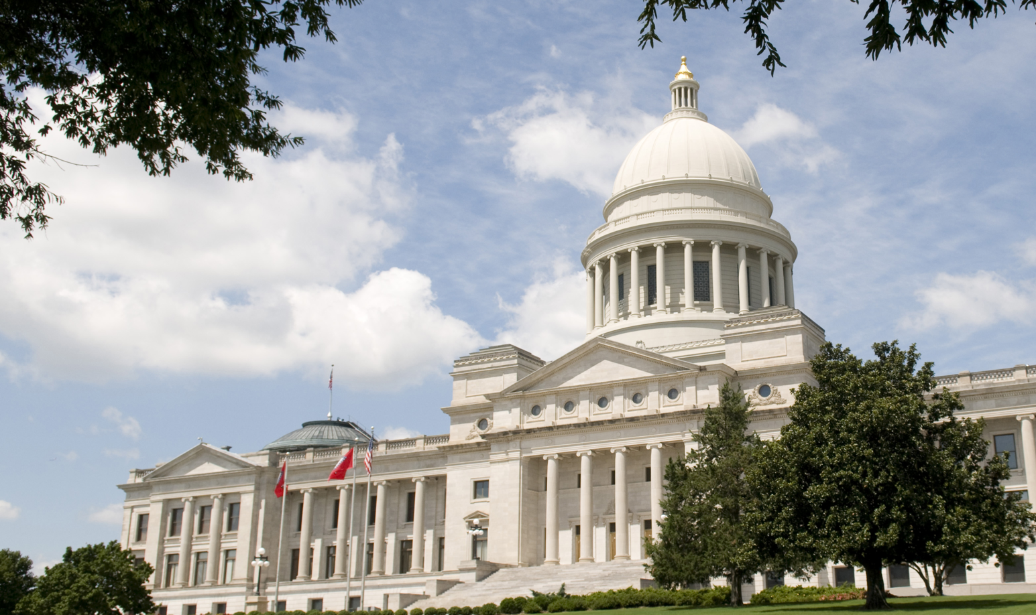

Notes:
State Board of Finance Investment Operation and Returns, 3rd Quarter - 2019

