Slide 1

State Board of Finance
Investment Operation and Returns
1st Quarter FY2021
Dennis Milligan
Arkansas Treasurer of State
Notes:
State Board of Finance Investment Operation and Returns, 3rd Quarter - 2019

Slide 2
Treasury Portfolio Allocation
*as of Sept. 30, 2020

Slide 3
Treasury Portfolio Allocation
*as of 9/30/2020

Slide 4
Total Revenue per Quarter
FY 17 – FY 21
Notes:
Fiscal Year 2016 through fiscal year 2019 quarterly total revenue comparison.

Slide 5
Short-Term Investment Revenue, Receipted
1st Quarter FY 2021

Slide 6
Long-Term Investment Revenue, Receipted
1st Quarter FY 2021

Slide 7
Total Earnings, Milligan Administration

Slide 8
Federal Reserve Economic Data
10-Year Treasury 2000-2020

Slide 9
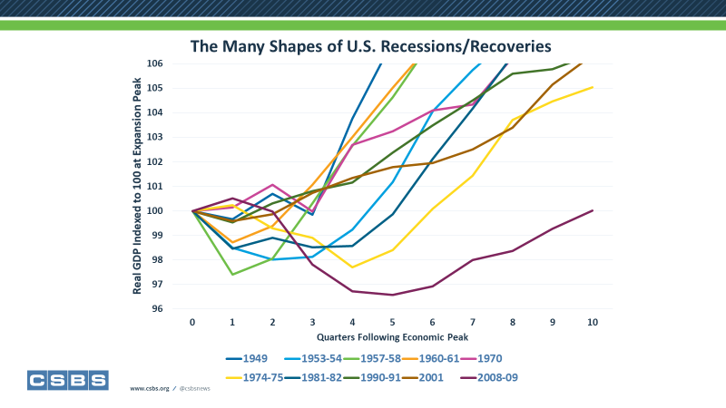
*Source: National Bureau of Economic Research (NBER) Business Cycle Dating Committee

Slide 10
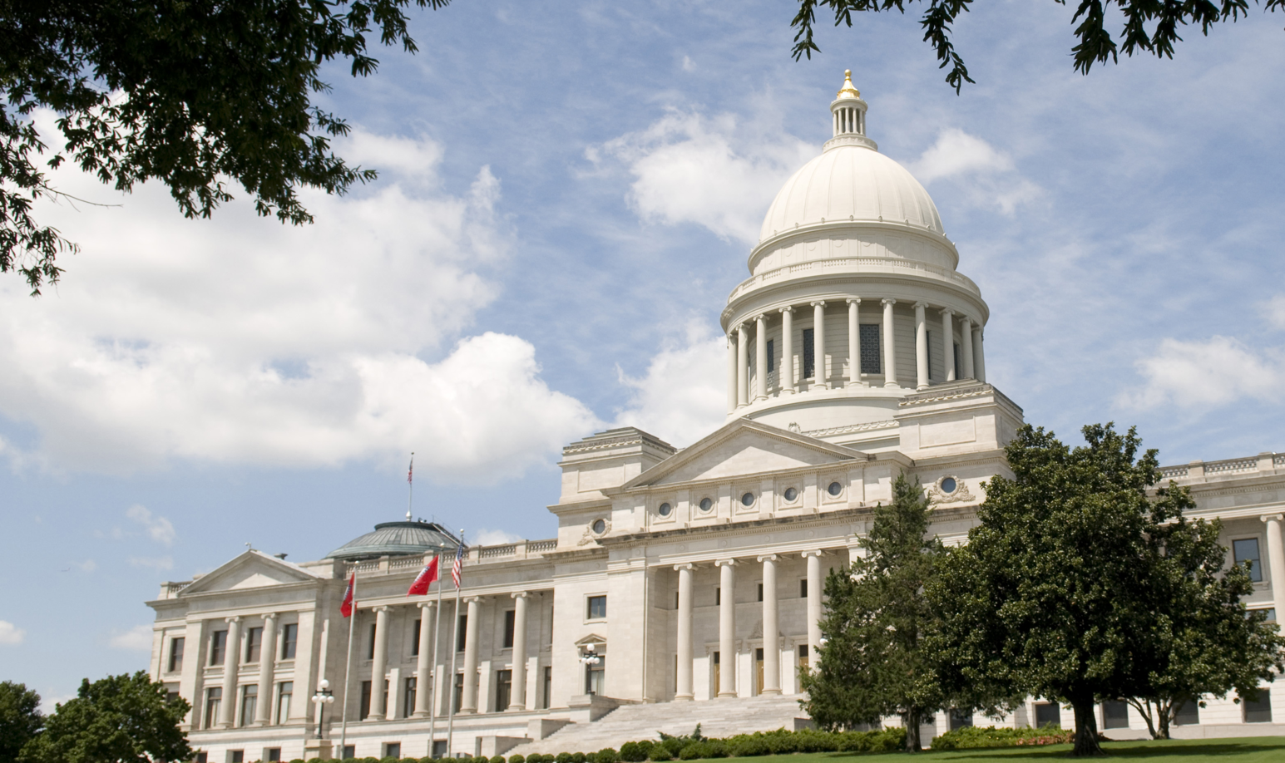

Notes:
State Board of Finance Investment Operation and Returns, 3rd Quarter - 2019

