Slide 1
Scale Training Seminar
Arkansas Bureau of Standards
2026

Slide 2
Objectives
Know and locate all applicable laws that pertain to registered servicepersons
Seal and Decal Policies
NTEP Requirement
NTEP Certificate of Conformance
Proper completion of Official Annual Test Reports
Requirement to adjust device as close as practicable to zero
What to do if a report is rejected
Proper Completion of Placed in Service Report (Form 1822)
What to do if a device is rejected

Slide 3
Laws pertaining to Registered Service Agencies and Persons
Arkansas Title 4 – Business and Commercial Law
AR Code § 4-18-308
AR Code § 4-18-322 (Prohibited Acts)
AR Code § 4-18-323 (Civil Penalties)
AR Code § 4-18-324 (Criminal Penalties)
AR Code § 4-18-344

Slide 4
AR Code § 4-18-344
  (b)
    (2)(A) A person who owns a pump or scale for a commercial transaction must engage a registered service agent to annually inspect and test for the accuracy and correctness of the pump or scale.

Slide 5
AR Code § 4-18-344
(c) A registered service agent shall perform the recalibration if the inspection or test indicates the bulk meter or liquefied petroleum gas metering device, pump, or scale needs to be recalibrated.
(d)
  (1) After the approval of a decal by the Arkansas Bureau of Standards, a registered service agent shall place an approved decal conspicuously on the bulk meter or liquefied petroleum gas metering device, pump, or scale which indicates that it is suitable for trade in accordance with the National Institute of Standards and Technology Handbooks 44 and 112, as adopted by the bureau.
  (3) A registered technician shall place an approved security seal on the device to prevent any unauthorized access to the adjusting mechanism unless otherwise authorized by the bureau.

Slide 6
AR Code § 4-18-344
(e) The registered service agent shall provide a copy of all bureau-approved inspection and test reports to the bulk meter or liquefied petroleum gas metering device, pump, or scale owner and to the director.
Note : A copy of the test report MUST be left on site at the time of the inspection
(f)
  (1) The registered service agent shall retain a copy of all inspection and test reports for a period of three (3) years.
  (2) The owner of the device shall retain a copy of all inspection and test reports at the device location for a period of three (3) years.

Slide 7
Voluntary Registration
Authorizes Servicepersons to remove rejection red seals and tags
Place devices into service that have been newly installed or rejected
Service person has in possession and will use all necessary testing equipment and standards; has full knowledge of Arkansas Weight & Measures laws and NIST Handbooks 44 &130 regulations and rules
Director is authorized to suspend or revoke a certificate of registration for:
-found taking unfair advantage of an owner of a device
  -failure to have test equipment or standards certified.
-failure to use adequate testing equipment
-failure to adjust commercial devices to comply with NIST Handbook 44 following a service or repair
-Repeated Offenses

Slide 8
Regulations pertaining to Voluntary Registration of Servicepersons and Service Agencies
NIST Handbook 130
Section IV. Uniform Regulation
Subsection D. Uniform Regulation for the Voluntary Registration of Servicepersons and Service Agencies for Commercial Weighing and Measuring Devices

Slide 9
Security Seals
If a device has a place or requires a physical seal, affix one
NTEP Certificate of Conformance describes the sealing required on each device
Apply seals only if you calibrate a device
Seals MUST be properly affixed to prevent tampering and adjustments. No loose wire.
Lead seals must be replaced with state approved seals
The Bureau of Standards DOES NOT provide decals or seals:
-Decal and seal ordering information found on our website

Slide 10
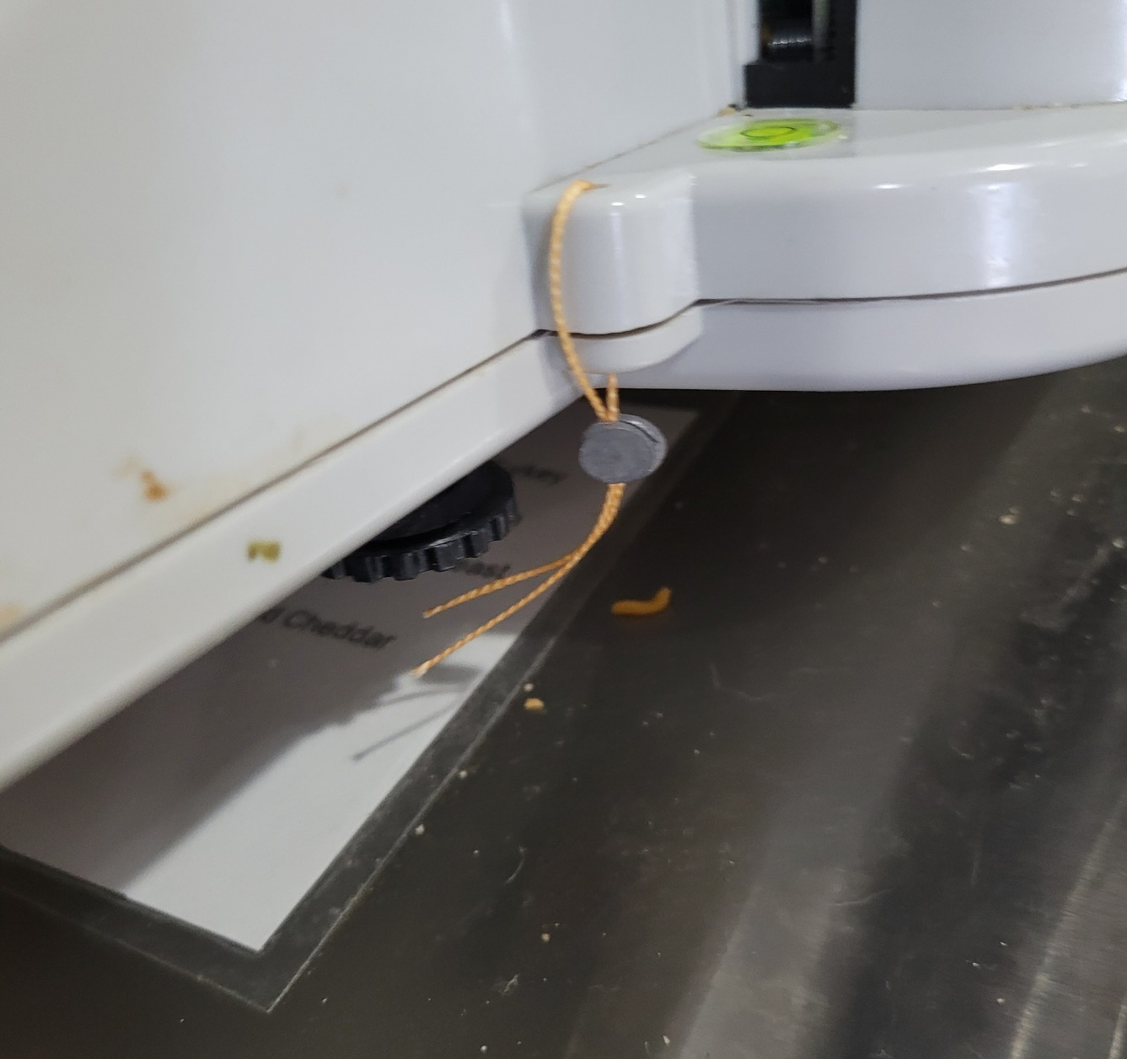
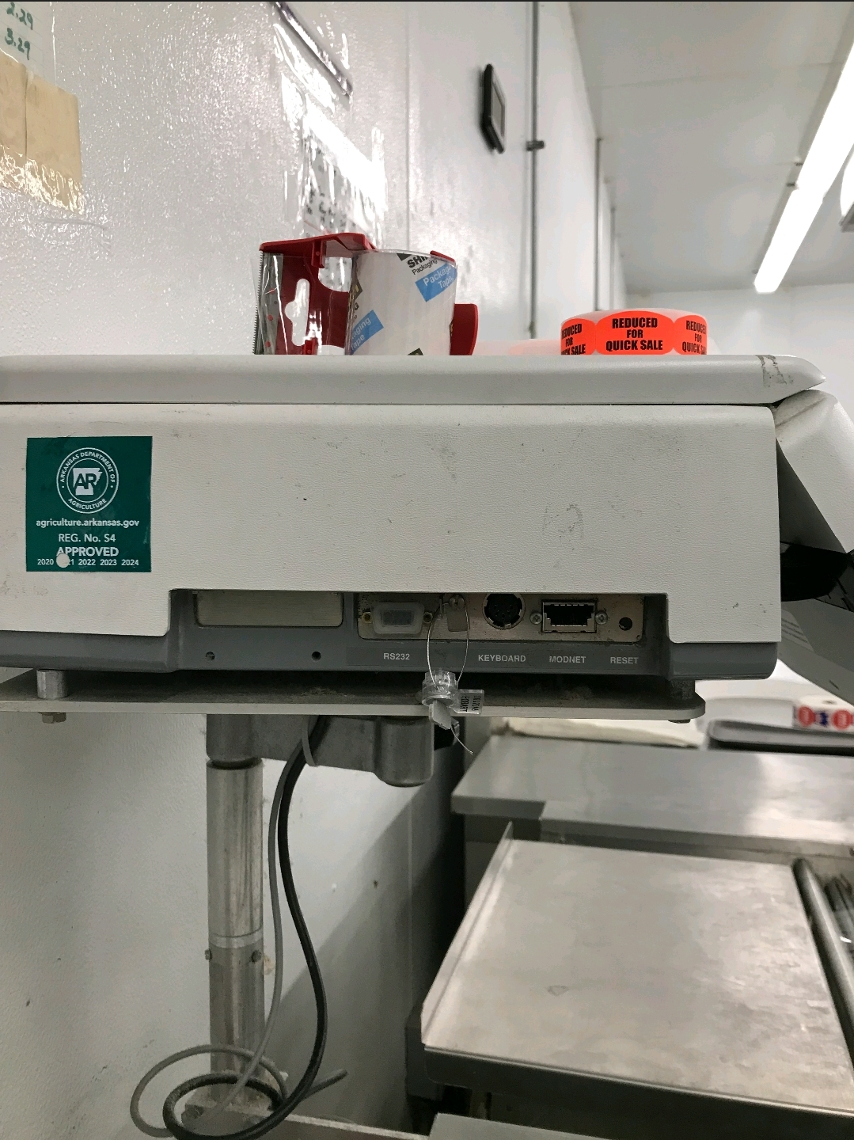
Security Seals
Lead Seal – Must be removed and replaced with state approved seal
Lead Seal – Must be removed and replaced with state approved seal

Slide 11
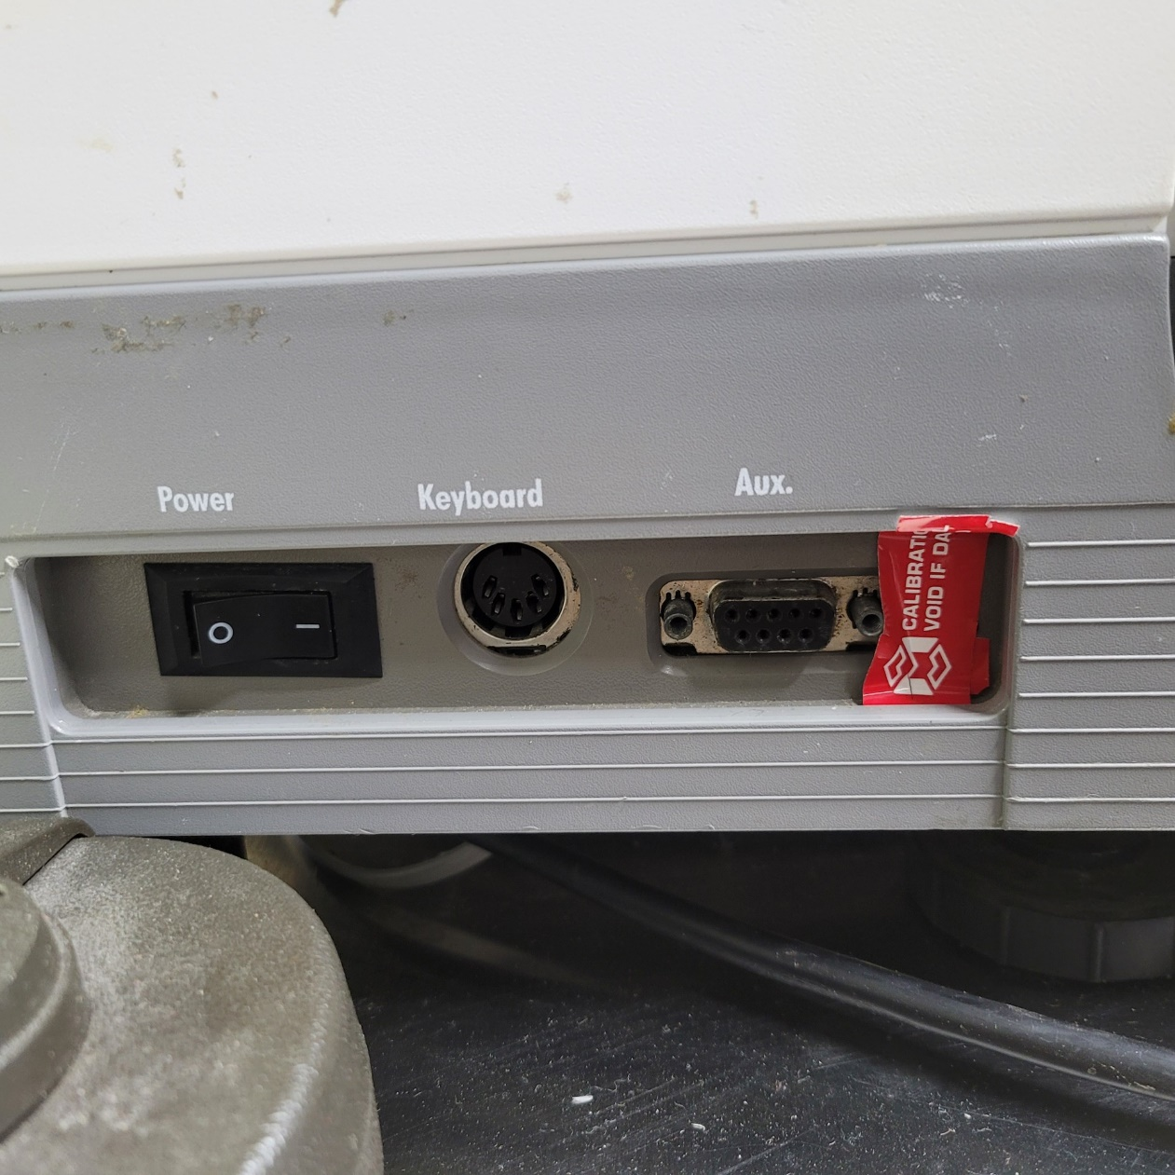
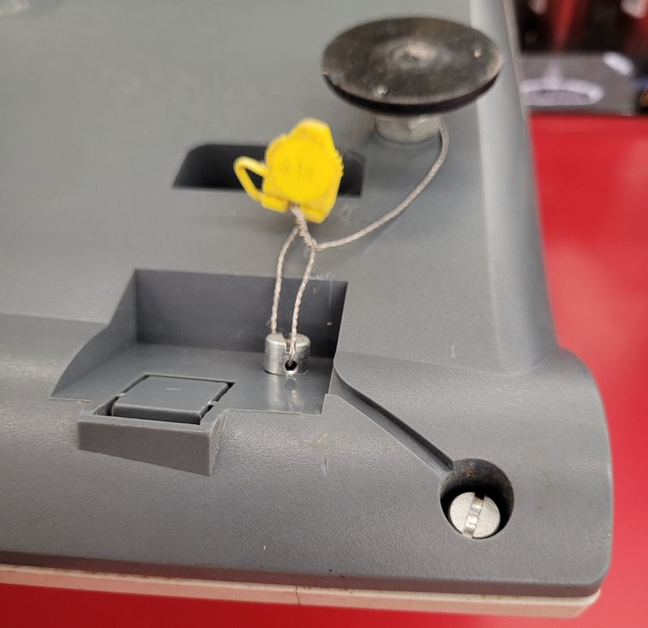
Security Seals
Pressure Seal – Physical Seals Trump Pressure Seals
Incorrectly Sealed – Tighten Wire

Slide 12
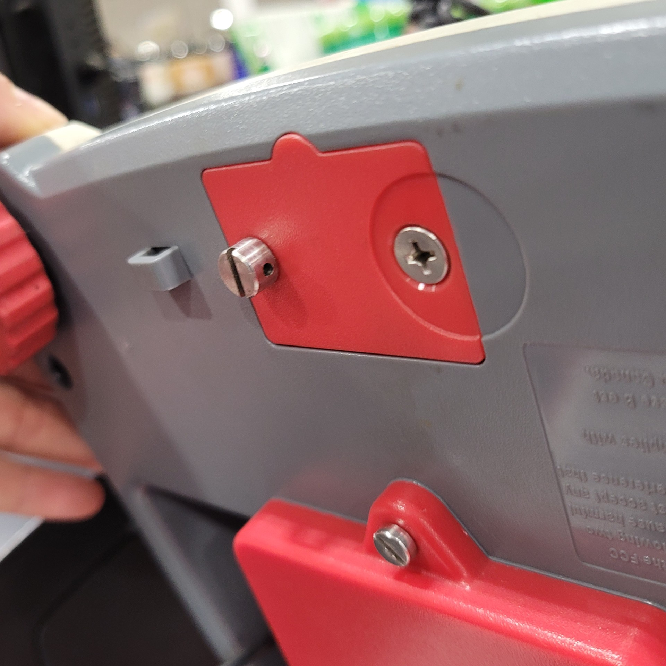
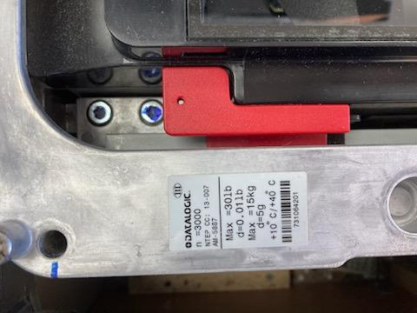
Security Seals
Missing Seal
Missing Seal

Slide 13
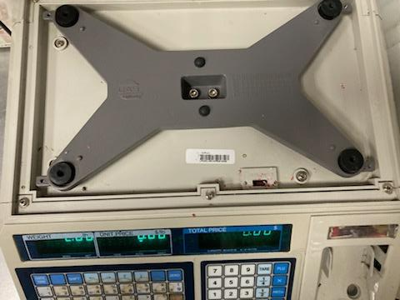
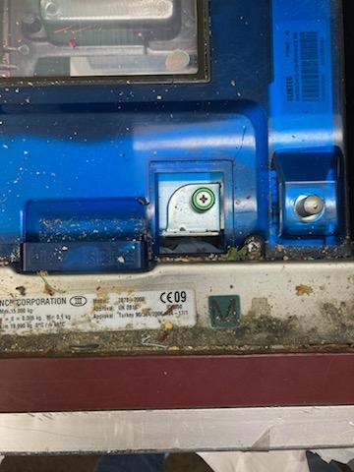
Security Seals
Missing Seal
Missing Seal

Slide 14
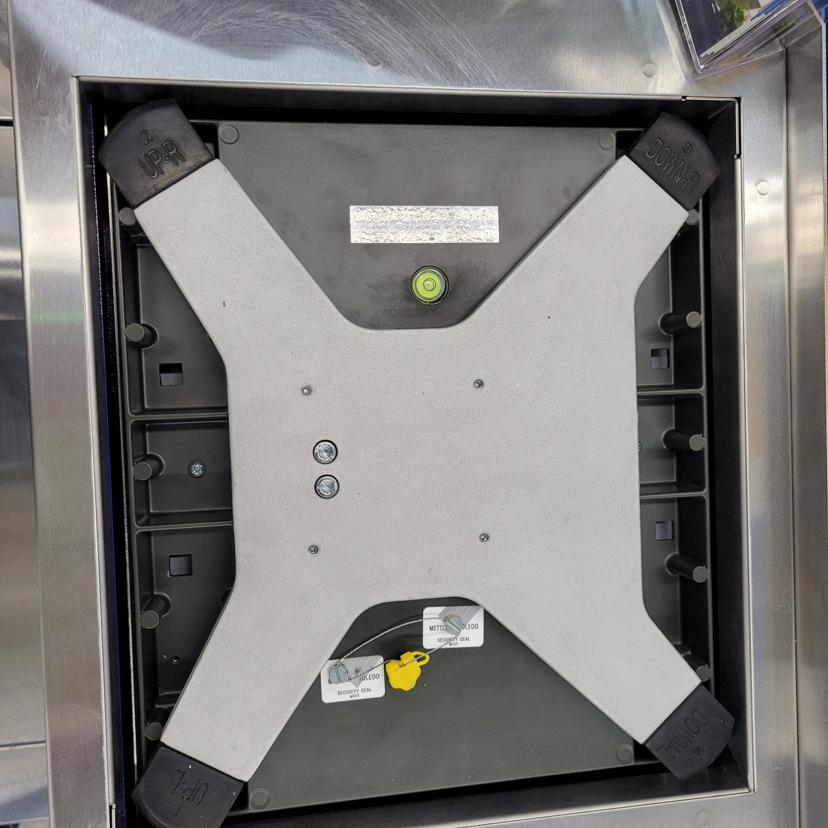
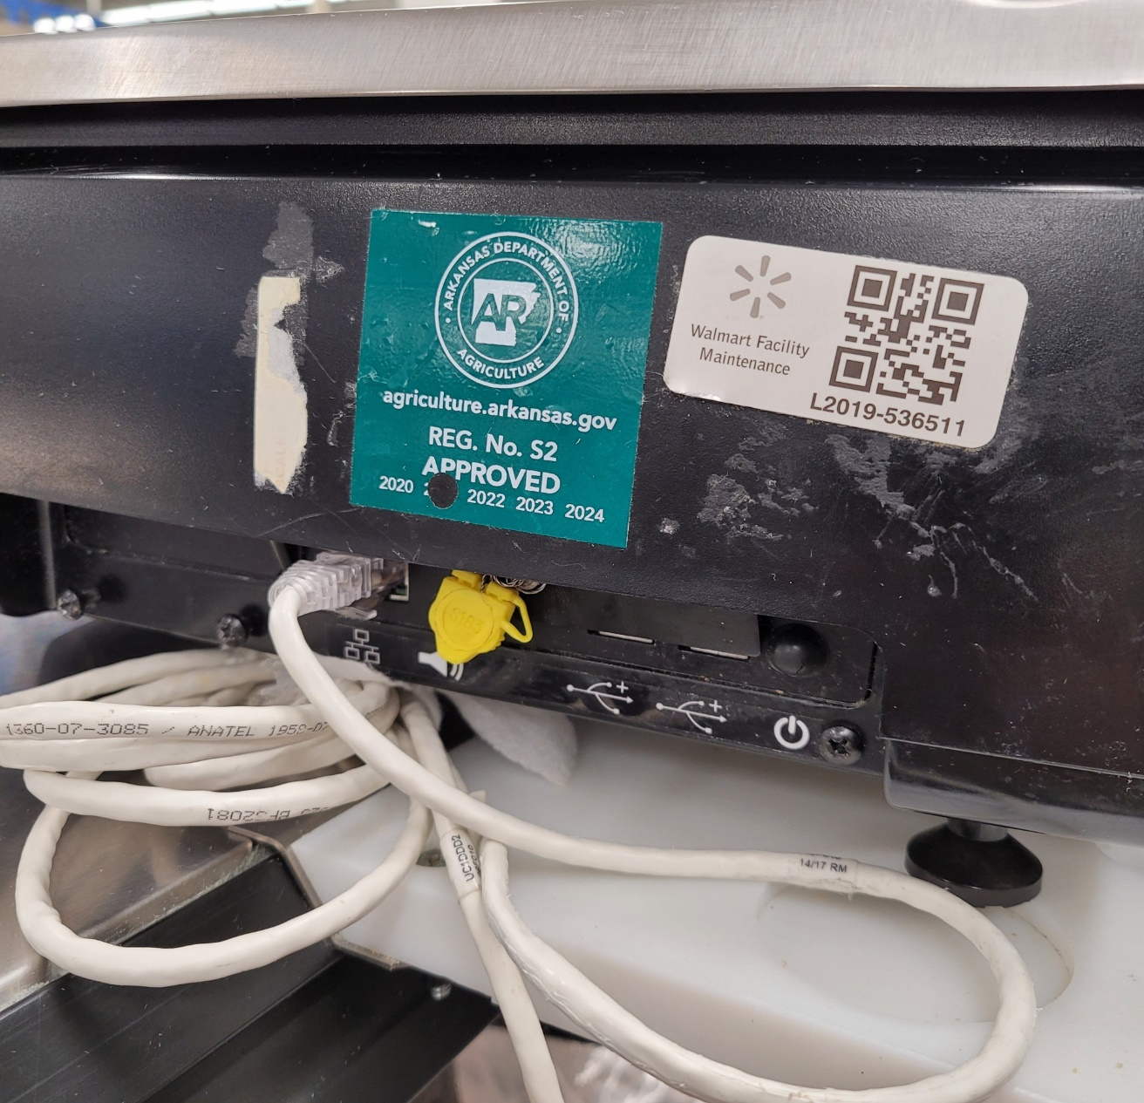
Security Seals
Correctly Affixed Seal
Correctly Affixed Seal

Slide 15
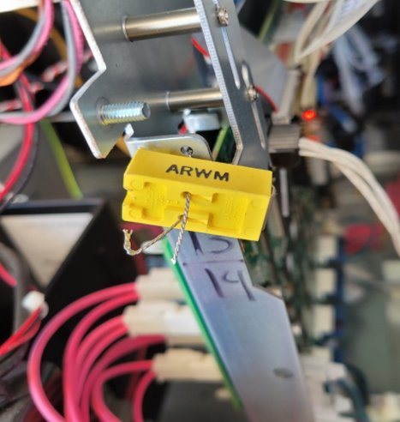


Security Seals
Example of State Approved Seal

Slide 16
Decals
Apply current (GREEN) annual decal only after testing and approving the device.
Remove all old decals before applying a new decal. No stacking decals.
Decals shall be affixed as close as possible to the customer indication as possible
Punch hole in decal for year of test.
You will be required to return to the facility to correct any issues

Slide 17
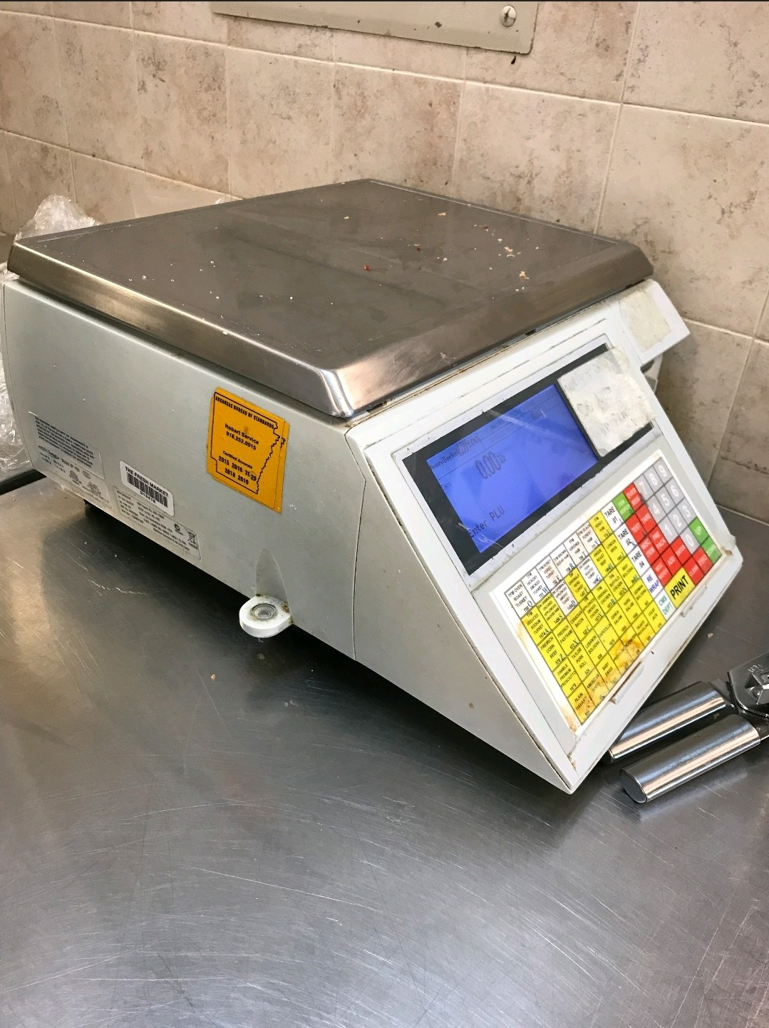
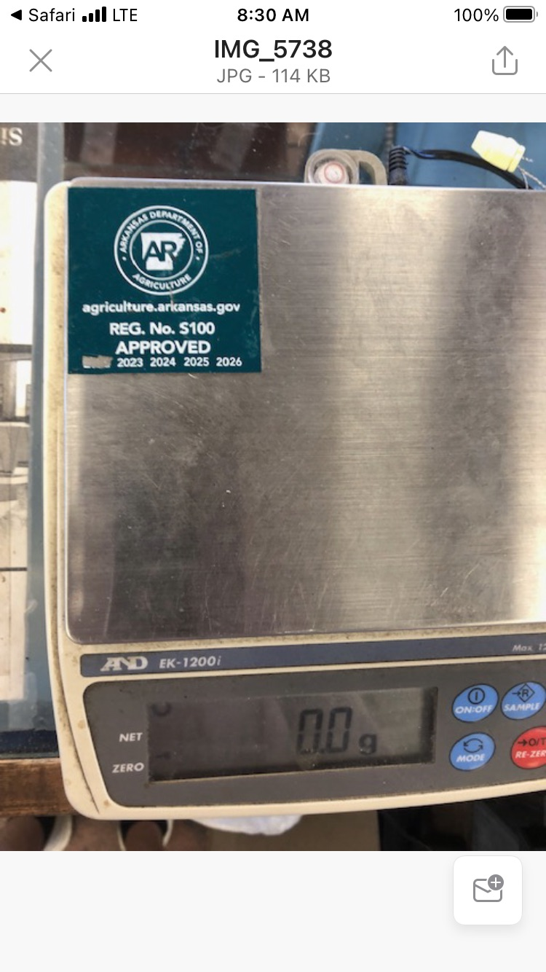
Decals
No Yellow Decals-Remove Old Decals
No Decals On Platters

Slide 18
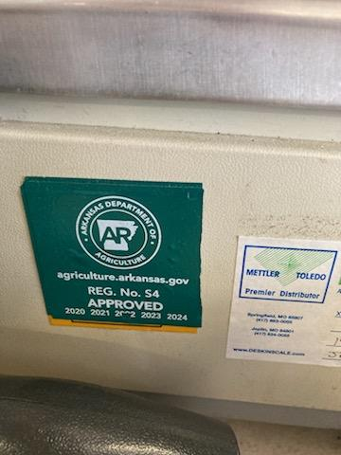
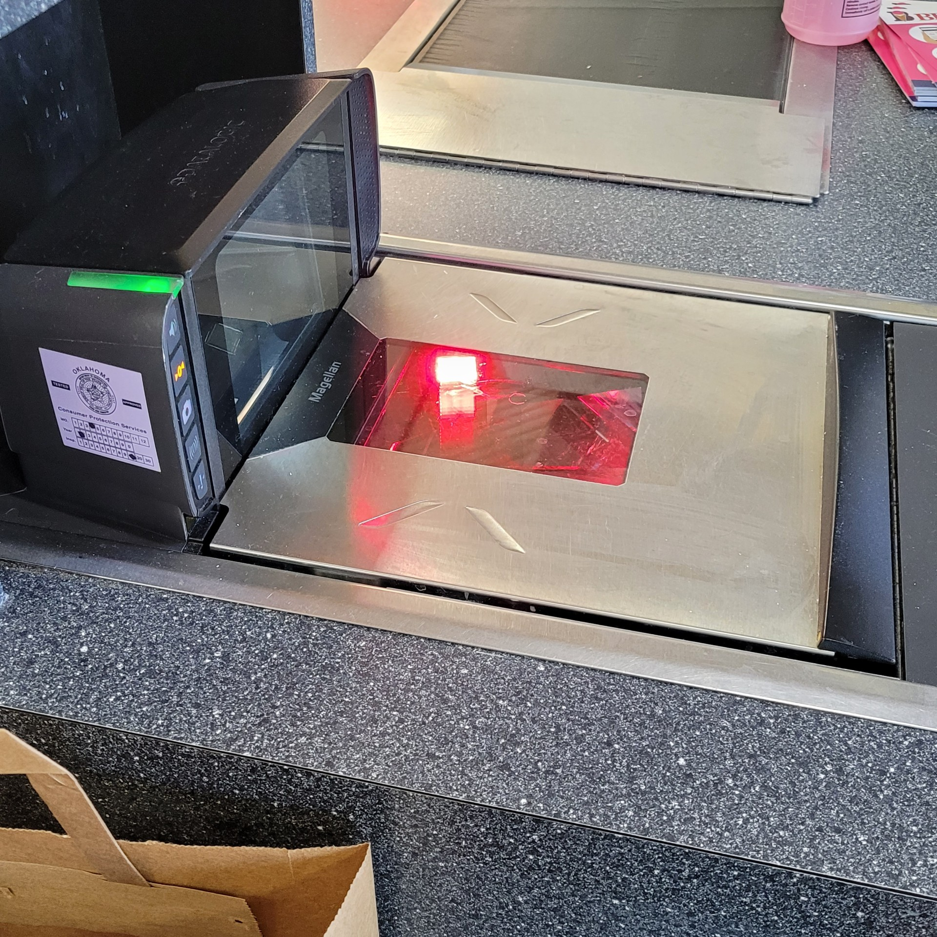
Decals
No Stacking Decals
Out of State Decals

Slide 19

National Type Evaluation Program

Slide 20
Locating the Devices
National Type Evaluation Program (NTEP)
Certificate of Conformance (CC)
Open Link - https://www.ncwm.com/ntep-certificates
Enter in Devices NTEP # located on data plate:
Example NTEP CC No. 95-122
20

Slide 21
National Type Evaluation Program
Devices installed in the state prior to January 01, 2003, are not required to have an NTEP CC marked on the device (Nonretroactive).
Devices can have certificates with both Inactive or Active status.

Slide 22
NIST Handbook 130 – Regulation for National Type Evaluation
Section IV. Uniform Regulation
Subsection E. Uniform Regulation for National Type Evaluation

Slide 23
OFFICAL ANNUAL TEST REPORTS
2026

Slide 24
Official Annual Test Reports
When to Perform Annual Tests
Improper Testing
Adjustment and Calibrations
Official Annual Field Test Report and Examples (Report Revised 2023)
When a report is rejected

Slide 25
When to Perform an Annual Inspection
When hired to do so by a customer in Arkansas.
Anytime a new or used device is newly installed.
Need only complete ONE Official Annual Inspection Report per year (when placing decals)

Slide 26
Improper Testing
Tests should be performed in accordance with the prescribed Examination Procedure Outline (EPO) as written in NIST Handbook 112. EPO’s No. 1.
Any scale 300lbs or less shall be tested to capacity.
If a device is adjusted, it must be retested to ensure compliance.
Service agencies are subject to fines and penalties if repeated offenses occur.

Slide 27
Adjustments or Calibrations
“The Registered Serviceperson or Service Agency is responsible for installing, repairing, and adjusting devices such that the devices are adjusted as closely as practicable to zero error.”
Appendix A (A-4) HB44 2.3. Tolerances and Adjustments. – Tolerances are primarily accuracy criteria for use by the regulatory official. However, when equipment is being adjusted for accuracy, either initially or following repair or official rejection, the objective should be to adjust as closely as practicable to zero error. Equipment owners should not take advantage of tolerances by deliberately adjusting their equipment to have a value, or to give performance, at or close to the tolerance limit. Nor should the repair or service personnel bring equipment merely within tolerance range when it is possible to adjust closer to zero error.

Slide 28
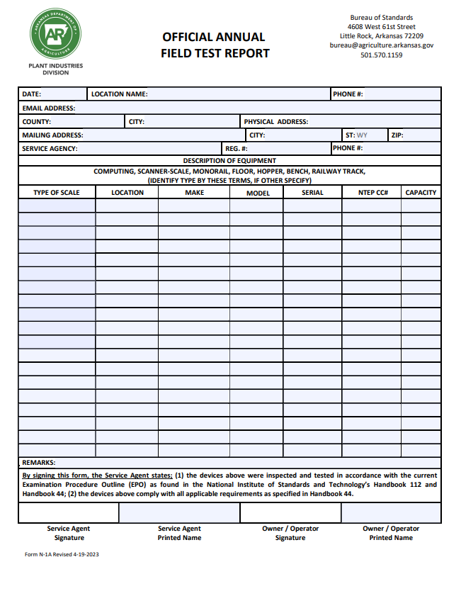
11/12/2024
Store #123
(555) 555-5555
Store123@aol.com
Garland
Hot Springs
123 Main Street
Same or Write if Different than Physical
123 Main Street
56245
Cool Agency LLC
S123
(777) 777-7777
POS #1 Front End Zebra MP7001 18202466594 17-056 30lbs
Computing Meat Dept Hobart Quantum 25-5565-654 95-122 30lbs
Joe Dirt
JoeDirt
Charles Smith
CHarlesSmith

Slide 29
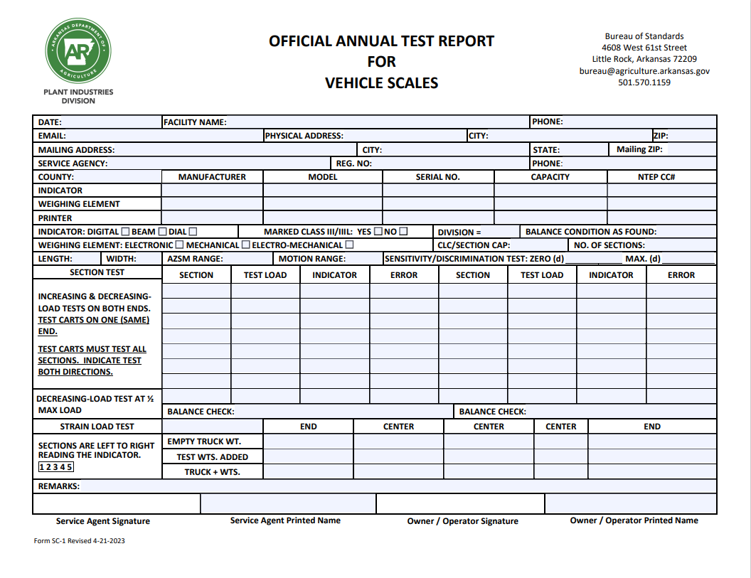
11/12/2024
Store #123
555-555-5555
Store123@aol.com
123 Main St
Hot Springs
72123
Write Same if Same as Physical/Write if different
Same
AR
Same
Cool Scales LLC
S123
555-555-555
Garland
Mettler - Toledo
Jaguar
MTJ94096
120000
94-096A2
Thurman
8130
T813088
120000
88-036A2
Rice-Lake
KB-105
RLKB105
120000
89-156
X
X
20
0
X
35K
4
11
30
30
0
12
1
4000
4000
0
4
4000
4000
0
8000
8000
0
8000
8000
0
12000
12020
+20
12000
12020
+20
16000
16020
+20
16000
16020
+20
20000
20020
+20
20000
20020
+20
24000
24020
+20
24000
24020
+20
28000
28020
+20
28000
28020
+20
16000
16000
0
16000
16000
0
OK
OK
24040
24040
24040
24040
28000
28000
28008
20000
52040
52040
52040
52040
Could not adjust twenty pound
John Smith
J. Smith
Charles Smith
CHarlesSmith

Slide 30
A Report is Rejected if…
The test results indicate the possibility the devices were not tested in accordance with the applicable Handbook 112 Examination Procedures Outline (EPO)
Not Legible
Not Complete
Not Correct

Slide 31
TEST REPORT MUST BE LEFT ON SITE AT THE TIME OF INSPECTION
AR Code § 4-18-344 (f)(1)(2)
Must retain copy for 3 years

Slide 32
Place in Service Reports (Form 1822)
2026

Slide 33
When to complete a Form 1822
When a device is newly installed at a location in the state
When a device is removed and reinstalled at a location in the state
When performing calibration of a device
Replacing metrological components on the device – Indicators, Load Cells etc.
When a device is Officially Rejected by the state

Slide 34
When to complete Form 1822
When a device is restored to service after officially rejected by the Bureau of Standards (Red Rejection Tag)
Placed into Service Report (Form 1822) shall be emailed to the Bureau of Standards within 24 hours of a device being returned to service
Email: bureau@agriculture.arkansas.gov
34

Slide 35
Rejection Red Tags and Seals
If a device has been officially rejected
  Servicepersons are authorized to remove Bureau applied tags and seals to repair devices
  If device IS NOT restored to FULL compliance
    Device is NOT to be returned to service
    Serviceperson shall reattach the original Bureau applied red tag with serviceperson’s properly attached security seal

Slide 36
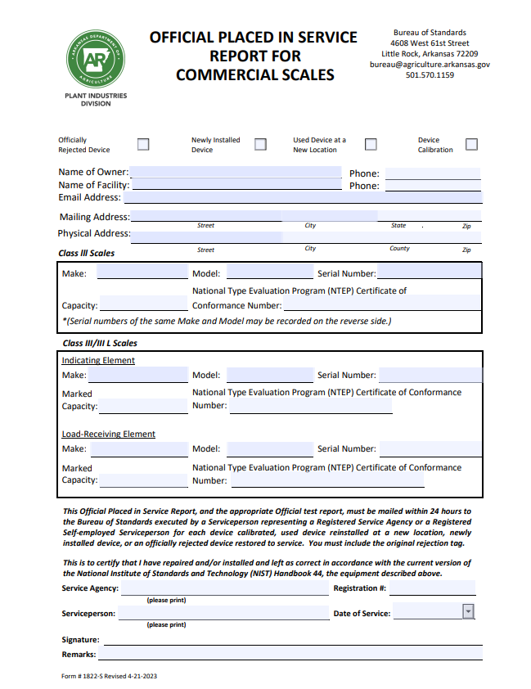
X
John Johnson
(555) 555-5555
Store #123
(555) 555-5555
store123@aol.com
Write Same or Write Other address if Different from physical address
123 Main Street Hot Springs Garland 52152
Zebra
MP7001
18202466594
30lbsc
17-056
Giant Scales LLC
S532
Mark Giant
01/01/2024
Mark Giant
Device Owner Signature

Slide 37
Scale Inspection and Testing Training
Arkansas Bureau of Standards
2026

Slide 38
Objectives
Upon completion of this presentation, you will be able to understand and describe Inspection for correctness & Testing for accuracy
    Referencing Handbook 44 using Handbook 112
      Safety
      Zero-load Balance as found
      General Considerations
      Marking Requirements
      Indicating and Recording Element
      Weighing element
      Testing
      Sealing

Slide 39
Handbook 112
Examination Procedure Outline (EPO) for Retail Computing Scales
EPO No. 1
Handbook 44
Device Requirements in Two Sections
Section 1.10. General Code
Section 2.20. Scales
OWM Examination Procedure Outlines (EPOs) | NIST

Slide 40
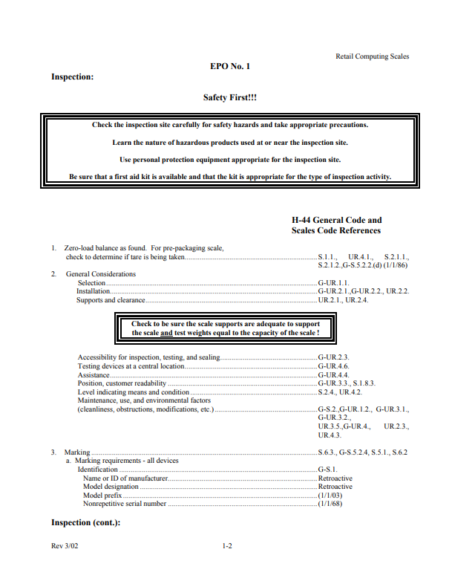
Handbook 44 Key
Handbook Key
  Any G- prefix
General code – Applies to all devices
  G-A – Application
  G-S – Specifications
  G-N – Notes
  G-T – Tolerances
  G-UR – User Requirements
OWM Examination Procedure Outlines (EPOs) | NIST

Slide 41
Handbook 44 Key
Handbook Key
Any code with no prefix
  Applies to only –
  Scales Code (Section 2.20)
    A. – Application
    S. – Specifications
    N. – Notes
    T. – Tolerances
    UR. – User Requirements
OWM Examination Procedure Outlines (EPOs) | NIST

Slide 42
General Code
Retroactive Requirements¹
  Enforceable on ALL EQUIPMENT
  Printed in Upright Roman Type in Handbook 44
  Example: Handbook 44 - G-S.1. (a) Marking Requirements Manufacturer
Nonretroactive Requirements²
  Enforceable on or after effective date
  Printed in Italics Type in Handbook 44
  Example: Handbook 44 - G-S.1. (e) Marking Requirements NTEP CC (January 1st, 2003)

Slide 43
EPO 1 Safety
2026

Slide 44
Safety
Supports:
Be certain that the installation is adequate to support the scale, test weights equal to the capacity of the scale, and any weight carts, test platforms, platters, chains, hooks, or other accessories used to suspend or support the test weights prior to proceeding with a testing procedure. Any test platforms, platters, chains, hooks, or other accessories must be capable of supporting the test weights necessary for the inspection.
Protective footwear.

Slide 45
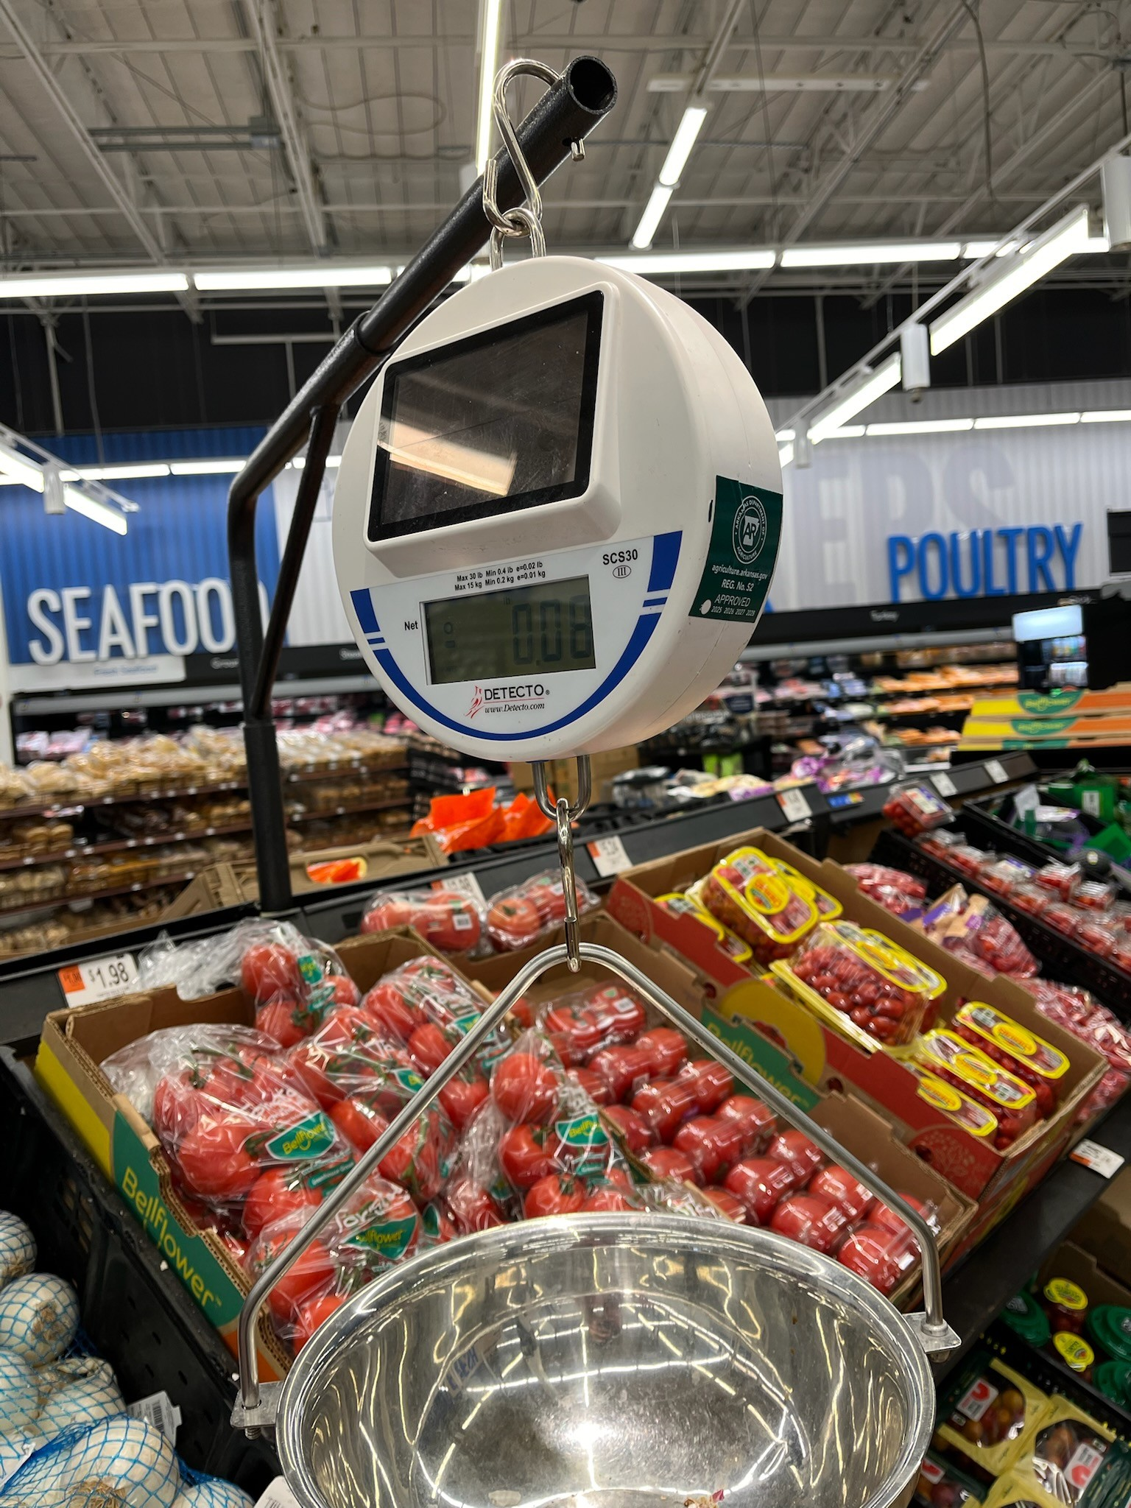
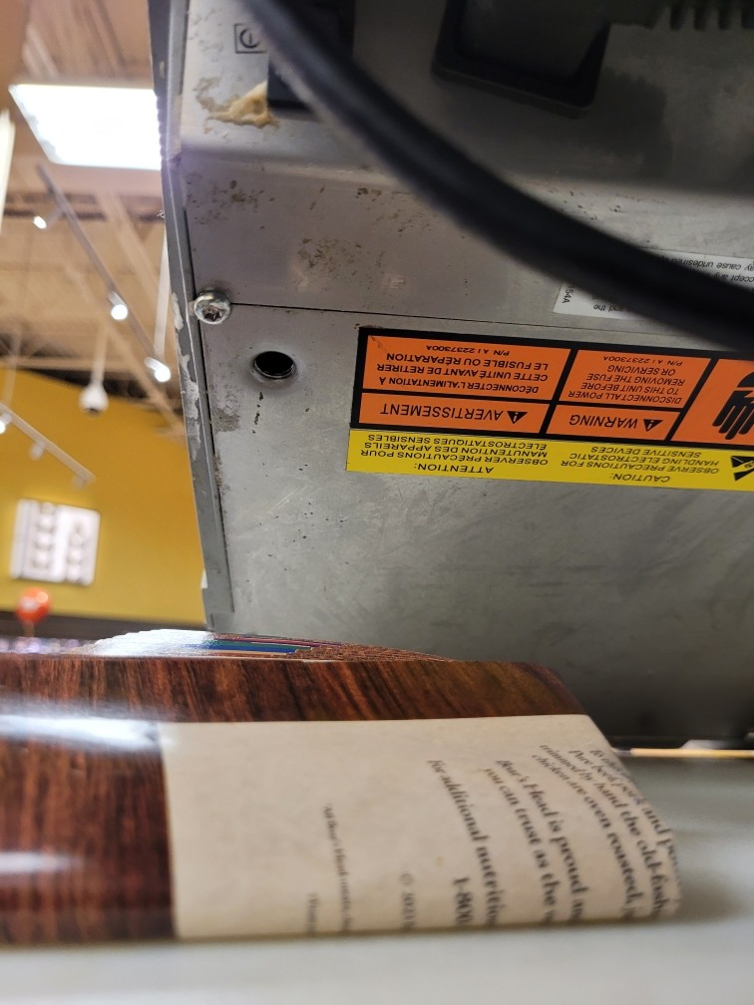
Safety
Check for proper Installation. These can tip over.
Check for proper Support. Leg missing. Do not apply weights.

Slide 46
EPO 1 Zero Load Balance
2026

Slide 47
Zero-Load Balance
Zero-load balance as found. For pre-packaging scale, check to determine if tare is being taken.
  S.1.1. Zero Indication
  (a) On a scale equipped with indicating or recording elements, provision shall be made to indicate or record zero-balance condition.
  UR.4.1.
  With no load on the load receiving element, scales shall indicate or record a zero-balance condition.

Slide 48
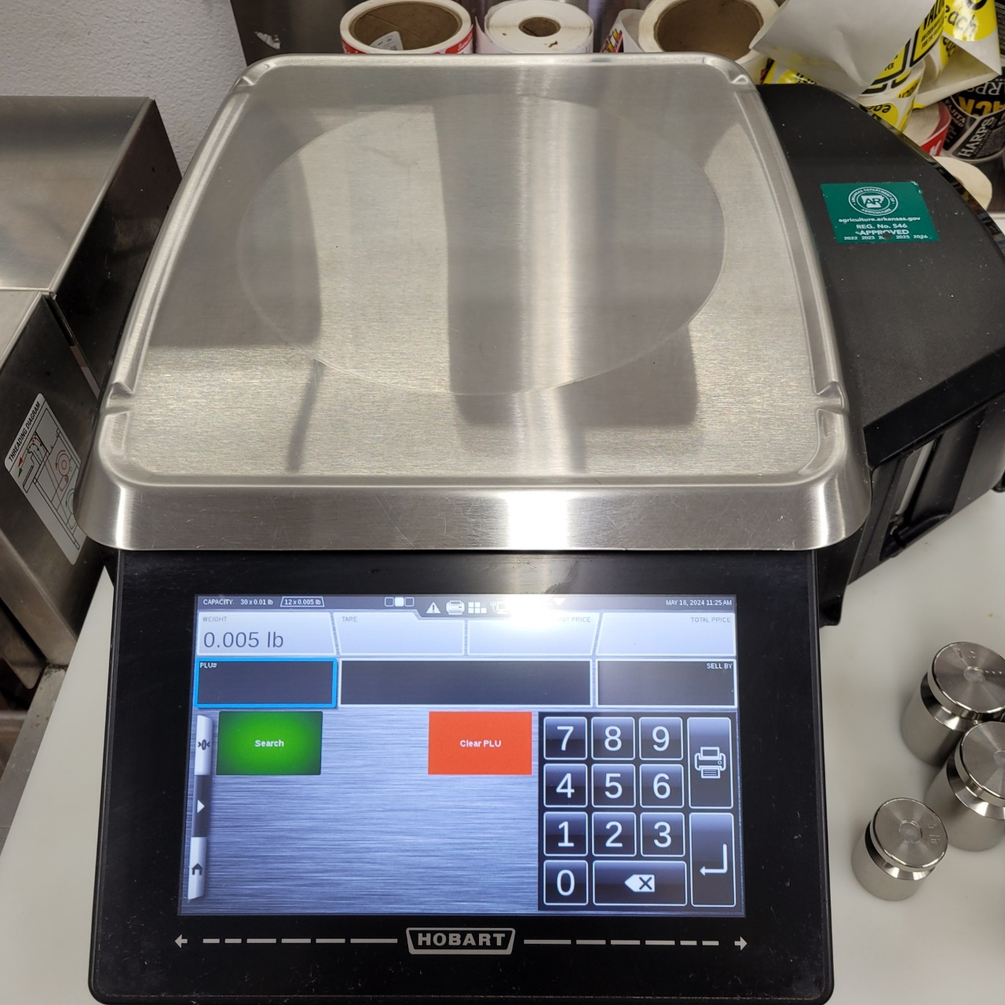
Zero-Load Balance
Must be found with zero load balance unless tare being taken:
Official Rejection
Red Tag
Remove from service

Slide 49
EPO 1 General Considerations
2026

Slide 50
General Consideration
Must be observed when:
  Purchasing
  Installing
  Inspecting
Selection
  G-UR.1.1. - Suitability of Equipment-is the scale suitable for which it will be used?

Slide 51
General Consideration
Installation
  G-UR.2.1. – Installation in accordance with manufacturer instructions.
  UR.2.2. – Suspension of Hanging Scale
Supports and Clearance
  UR.2.1. –Supports
  UR.2.4.- Foundations, Supports, Clearance. – weighing element must be clear at all times
Accessibility
  G-UR.2.3. – Accessible for inspection, testing, sealing

Slide 52
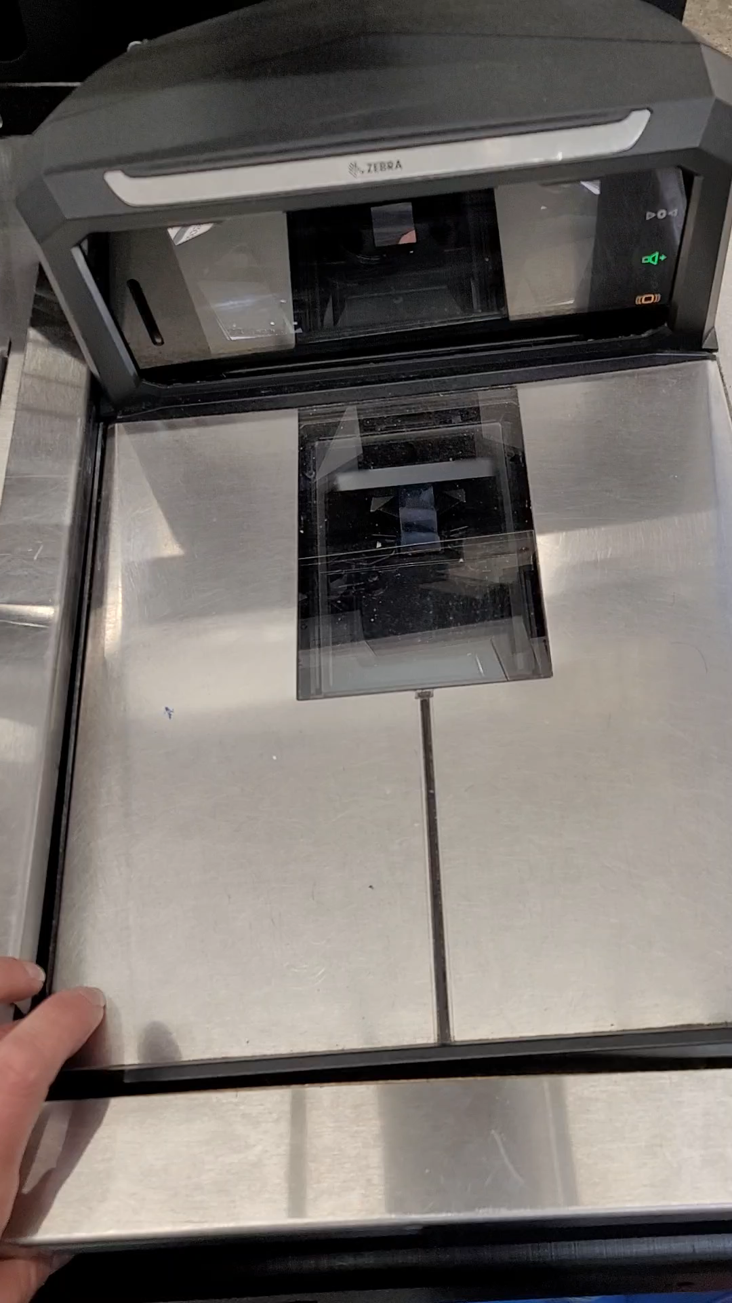
General Consideration
Improper Installation:
Official Rejection
Red Tag
Remove from service

Slide 53
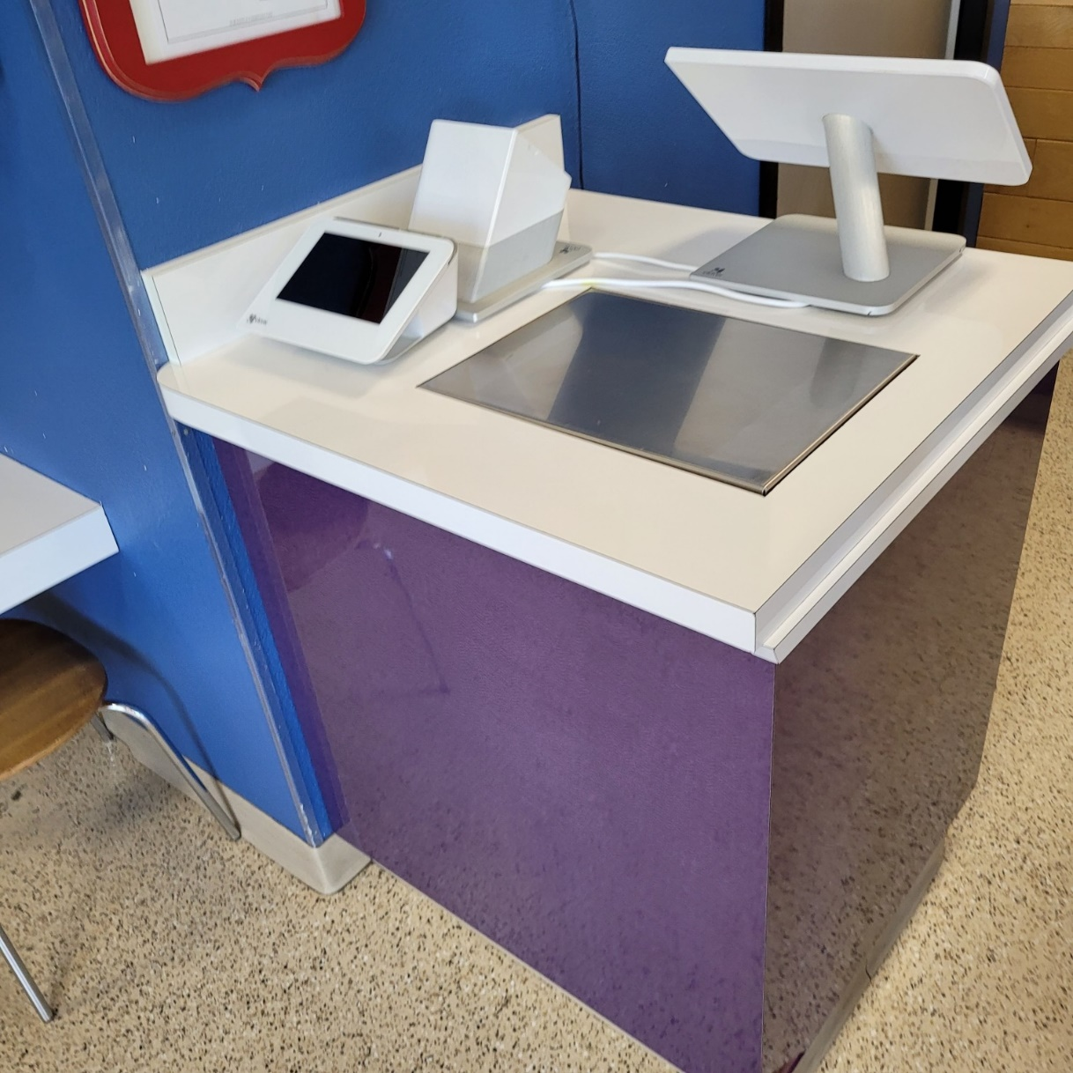
General Consideration
Improper Installation:
Cannot access seal or data plate

Slide 54
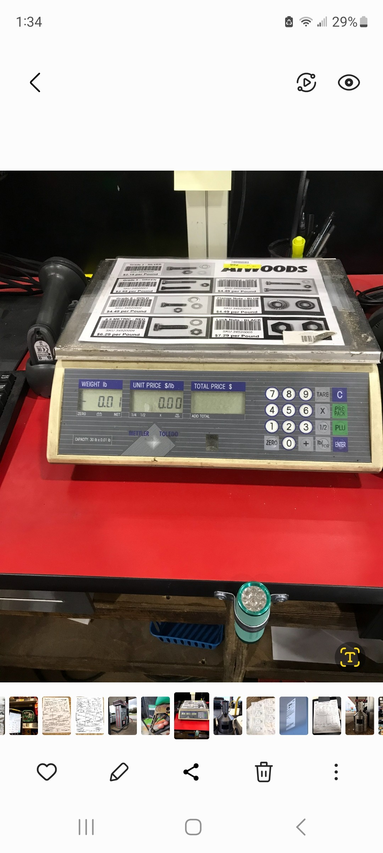
General Consideration
Clearance: Regulation states weighing elements must have clearance at all times.

Slide 55
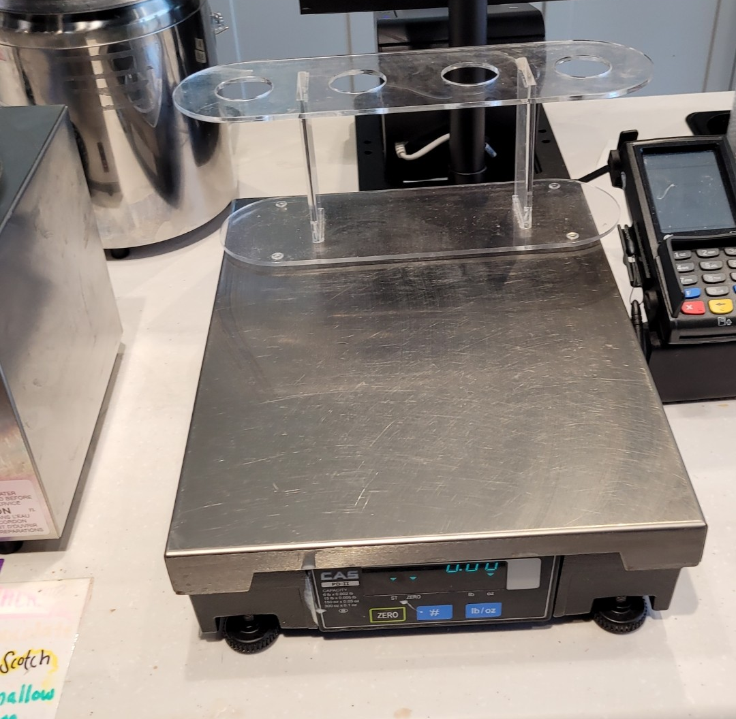
General Considerations
Clearance: Regulation states scale must always have clearance on weighing element.

Slide 56
General Consideration
Position and Customer Readability
  G-UR.3.3. Position of Equipment- scales used in direct sales, customer must be able to observe primary indicator by some reasonable distance
Level Indicating Means and Condition
  UR.4.2. – scales must be level, if equipped with level indicator

Slide 57
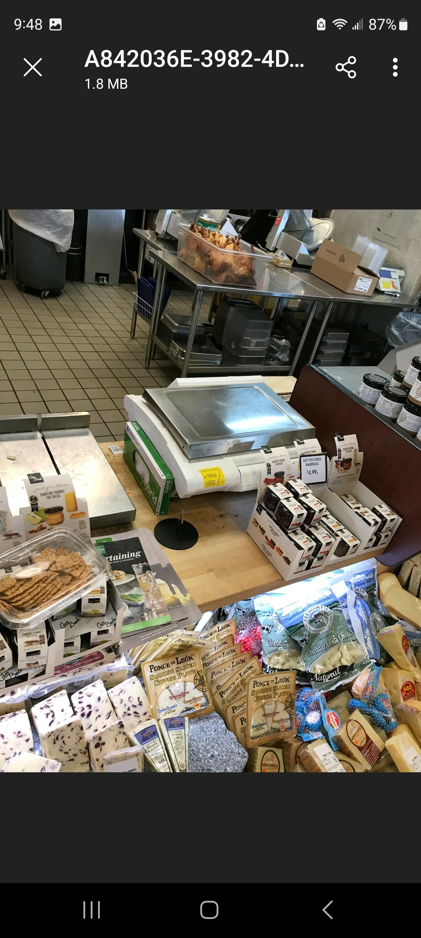
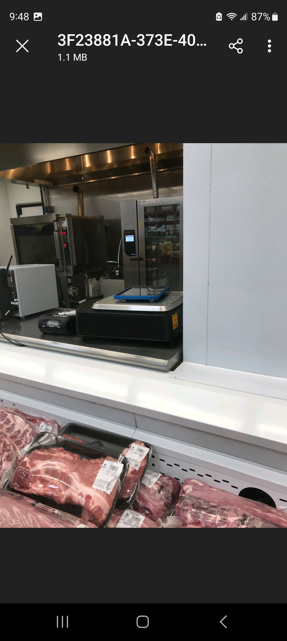
General Considerations
Position and Customer Readability: During direct sales, customer must be able to see indicator.

Slide 58
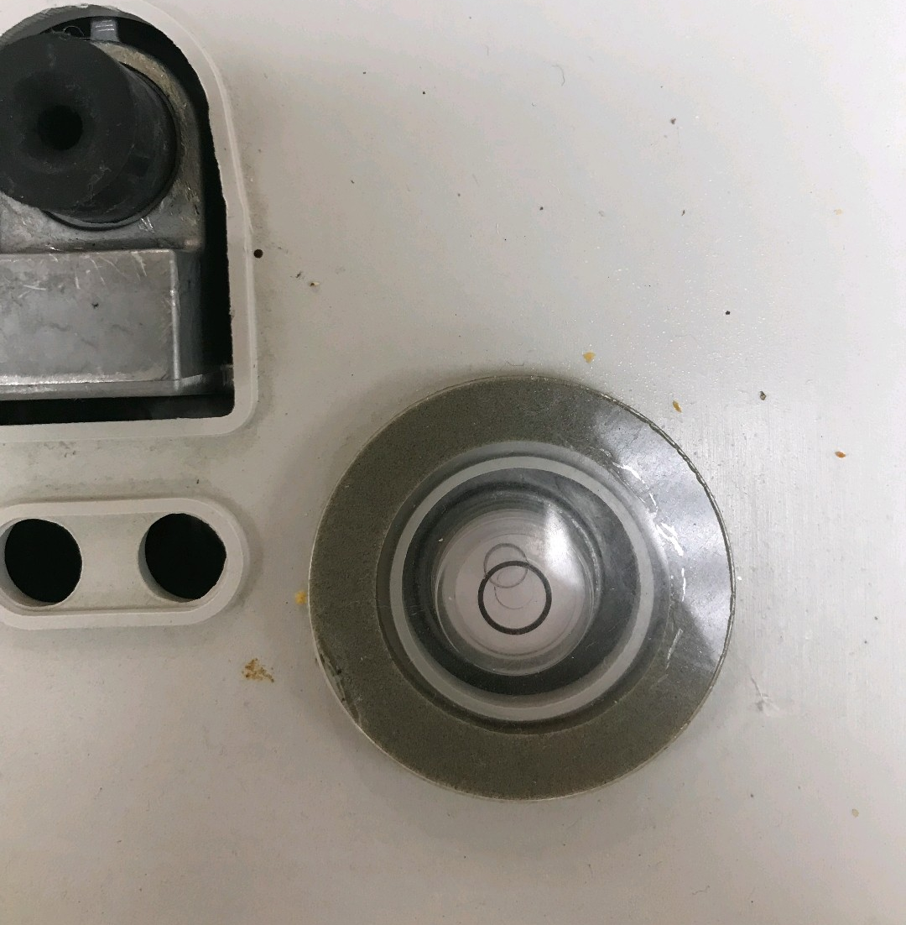
General Consideration
Level: if the scale is equipped with level. Scale must be level.

Slide 59
General Considerations
Maintenance, use, and environmental factors
  G-UR.1.2. Environment.
    equipment should be suitable for the environment in which it is used including, but not limited to, the effects of wind, weather, and RFI.
      -Scrap Yards/Landfills/RFI near Indicator
      -Garden Centers with Electric Fans
      -Delis with Electric Fans

Slide 60
General Considerations
Maintenance, use, and environmental factors continued…
  G-UR.4.1. Maintenance of Equipment
  -all equipment in service and all mechanisms and devices attached thereto or used in conjunction therewith shall be continuously maintained in proper operating condition throughout the period of such service.

Slide 61
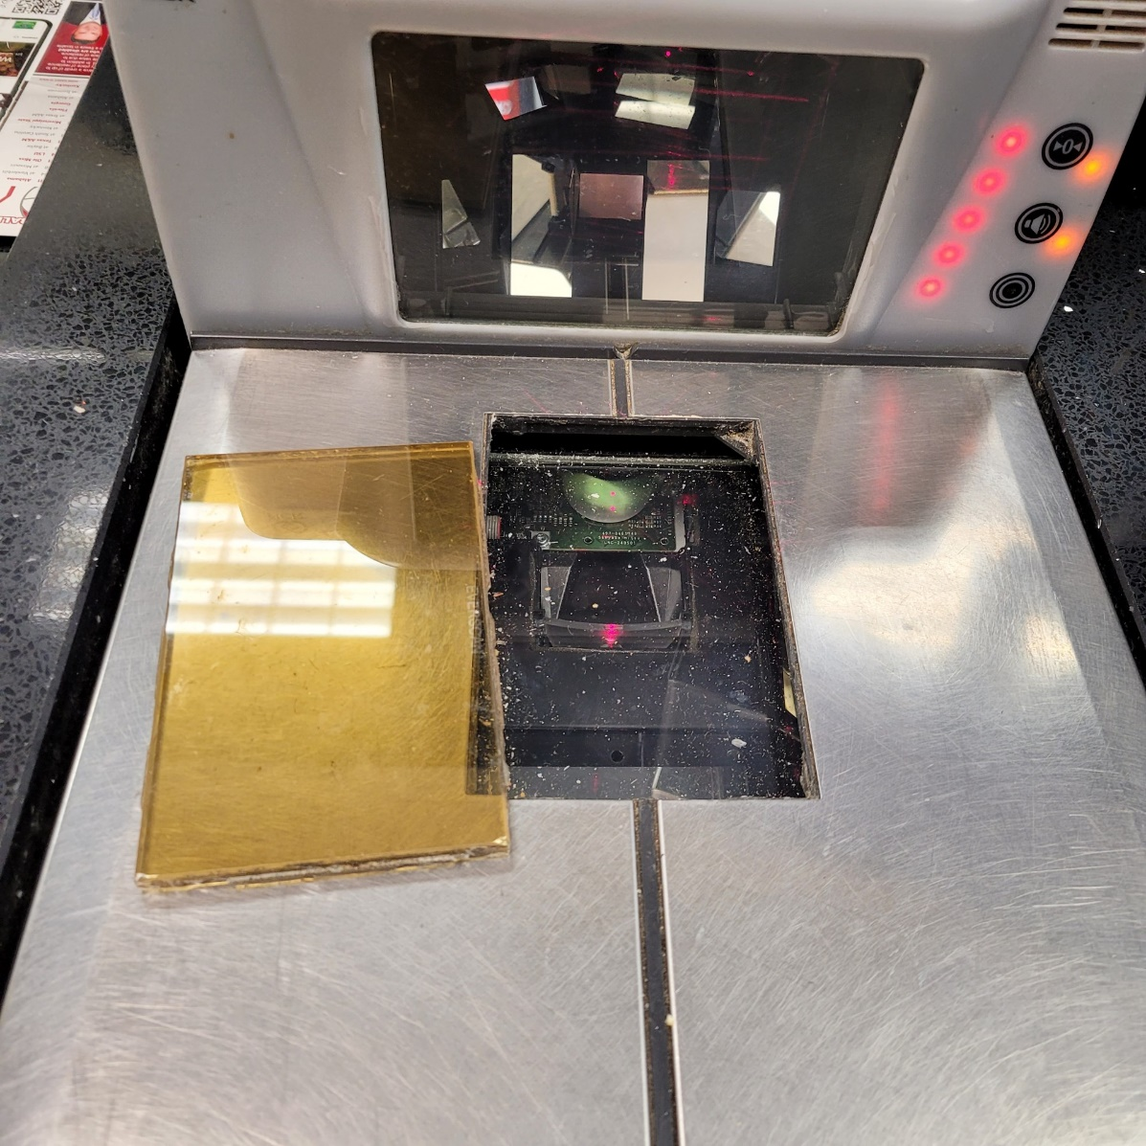
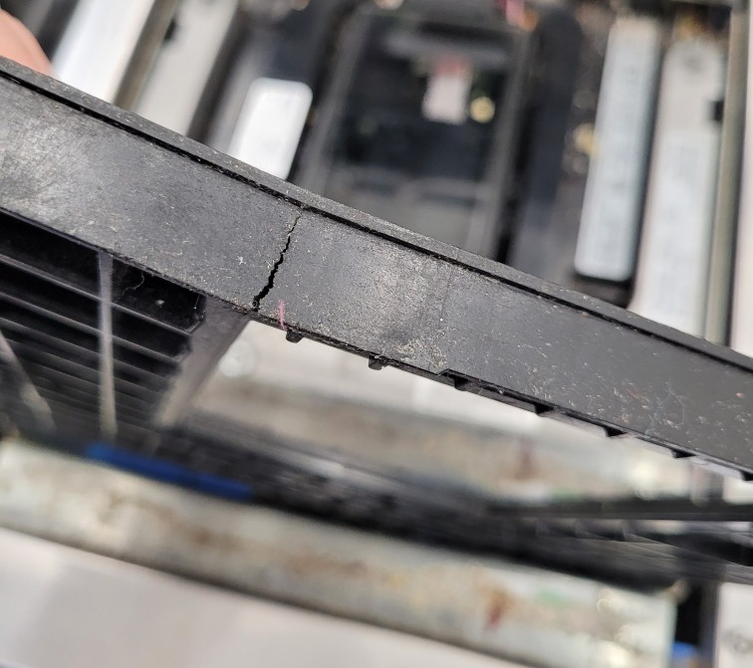
General Considerations
Maintenance of Equipment. Official rejection. Red tag.

Slide 62
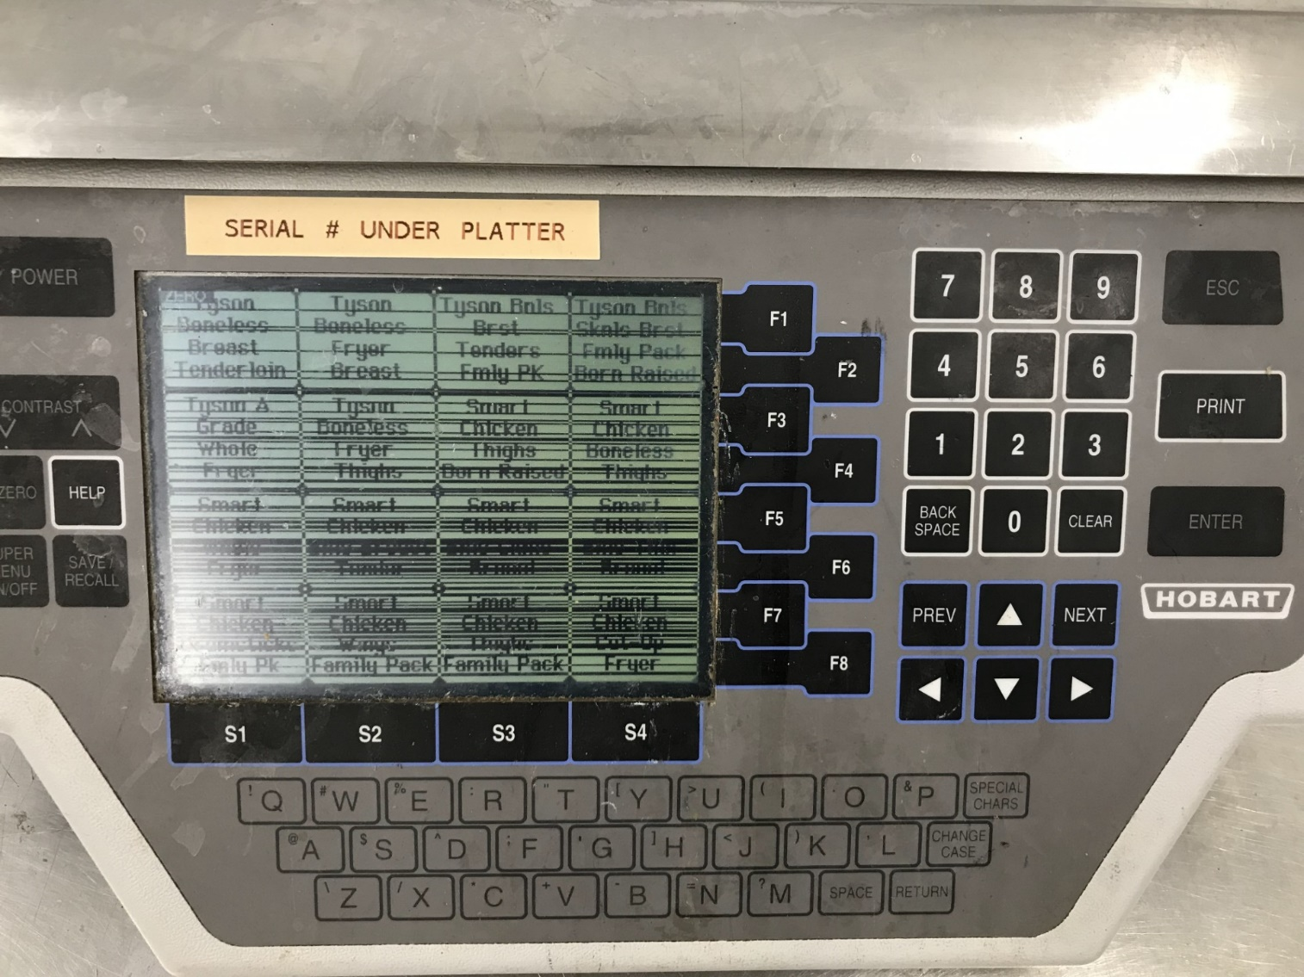
General Considerations
Maintenance of Equipment. Official rejection. Red tag.

Slide 63
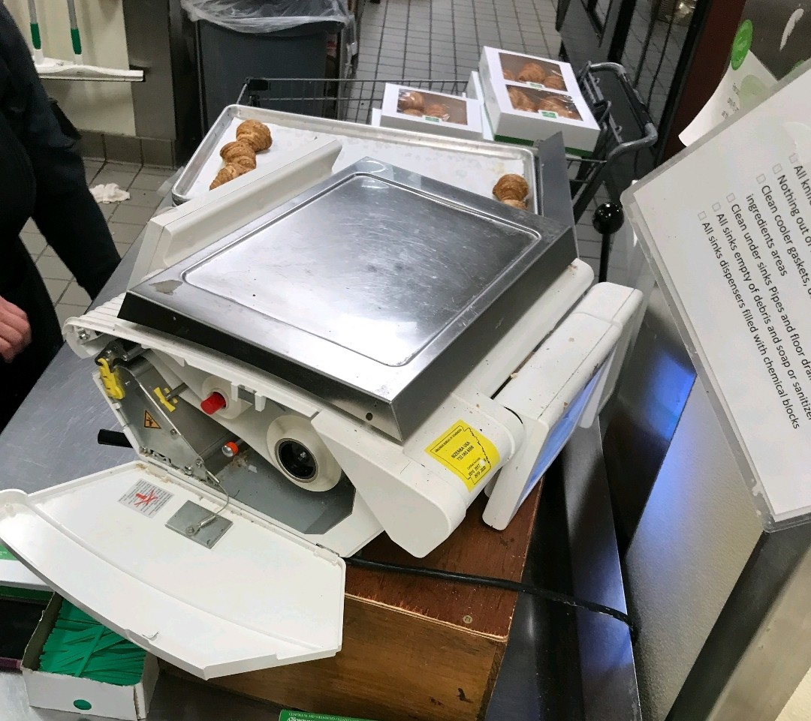
General Consideration
Maintenance of Equipment. Printer broken Official rejection. Red tag.

Slide 64
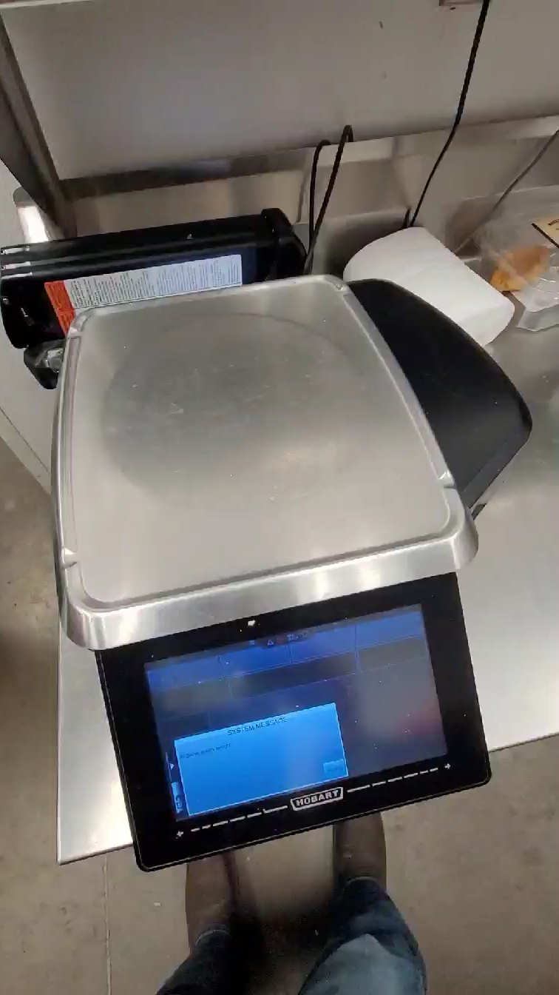
Maintenance of Equipment. Detached load Cell. Red tag
General Considerations

Slide 65
EPO 1 Marking Requirements
2026

Slide 66
Marking Requirements
Marking requirements for all devices
  G-S.1. Identification
    Name, initial, trademark of Manufacturer
    Model identifier
    Non repetitive serial number (nonretroactive)
    Current software version or identifier
    National Type Evaluation Program Certificate of Conformance Number (nonretroactive)

Slide 67
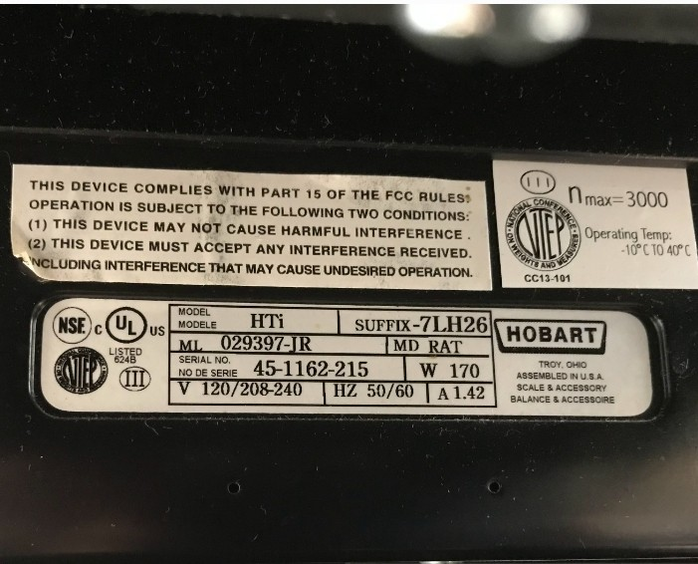
Marking Requirements

Slide 68
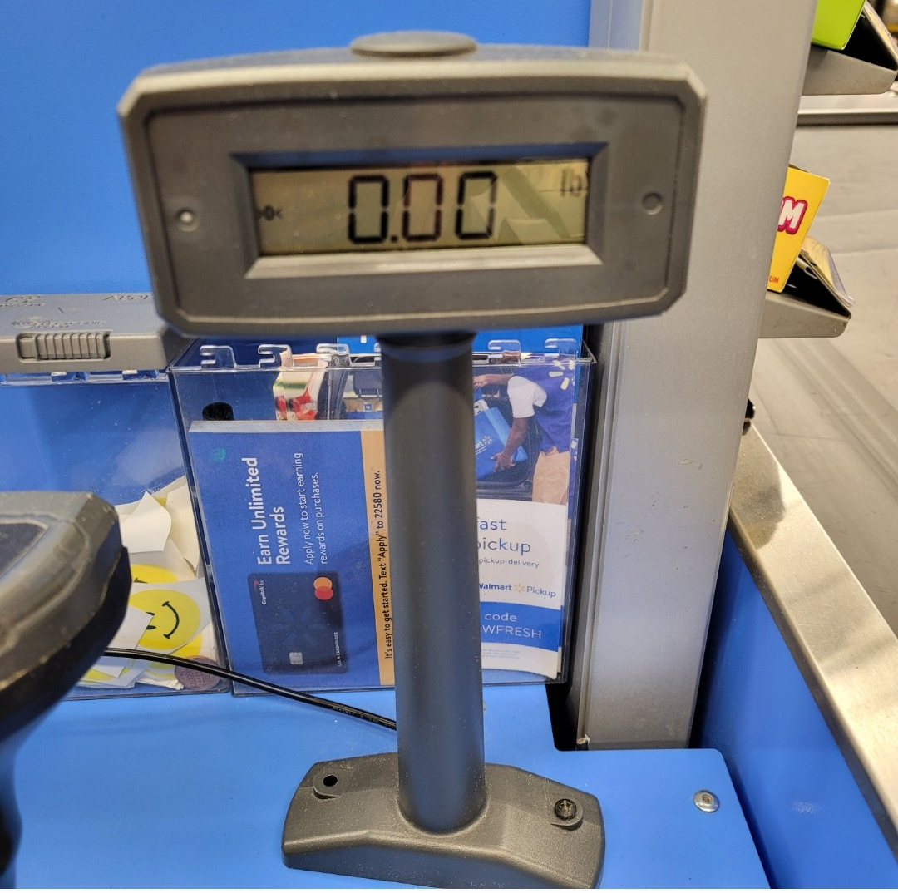
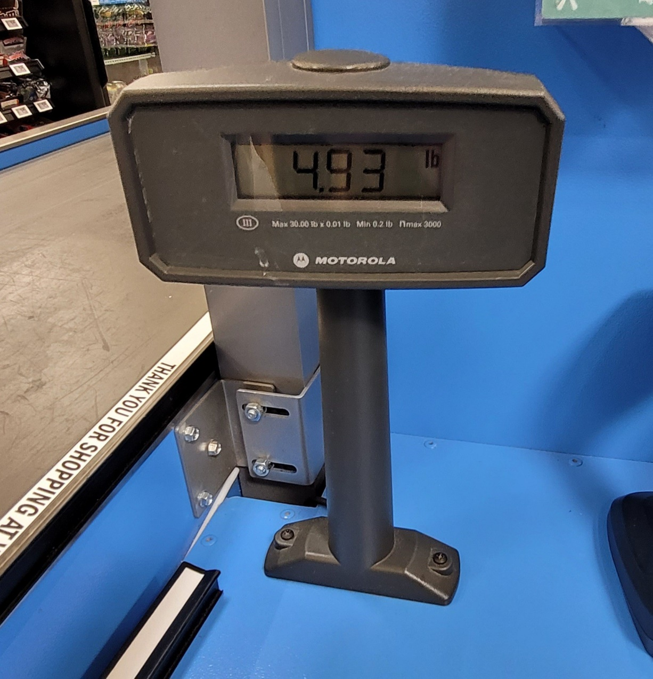
Marking Requirements
Marking: Marking required on primary and secondary indicators.

Slide 69
EPO 1 Indicating and Recording Elements
2026

Slide 70
Value of Scale Division
S.1.2. Value of Scale Division Units - Except for batching scales and weighing systems used exclusively for weighing in predetermined amounts, the value of a scale division “d” expressed in a unit of weight shall be equal to:
  (a) 1, 2, or 5; or
  (b) a decimal multiple or submultiple of 1, 2, or 5; or Examples: scale divisions may be 10, 20, 50, 100; or 0.01, 0.02, 0.05; or 0.1, 0.2, 0.5, etc.
  (c)a binary submultiple of a specific unit of weight. Examples: scale divisions may be ½, ¼, 1 /8, 1 /16, etc.
  [Nonretroactive as of January 1, 1986]

Slide 71
Value of Tare Division
S.2.3. Tare. – On any scale (except a monorail scale equipped with digital indications and multi-interval scales or multiple range scales when the value of tare is determined in a lower weighing range or weighing segment), the value of the tare division shall be equal to the value of the scale division.* The tare mechanism shall operate only in a backward direction (that is, in a direction of under-registration) with respect to the zero-load balance condition of the scale. A device designed to automatically clear any tare value shall also be designed to prevent the automatic clearing of tare until a complete transaction has been indicated. * [*Nonretroactive as of January 1, 1983] (Amended 1985 and 2008)

Slide 72
EPO 1 Pretest Determinations
2026

Slide 73
Tolerance
To prepare for testing, determine what tolerance is applicable to the device.
1.10. General Code, G-T. Tolerances
Acceptance Tolerance G-T.1. These tolerances shall apply to equipment; | Maintenance Tolerance G-T.2.
To be put into commercial use for the first time | These tolerances shall apply to equipment in use, except as provided in G-T.1. Acceptance Tolerances
That has been placed in commercial service within the preceding 30 days and is being officially tested for the first time
That has been returned to commercial service following official rejection for failure to conform to performance requirements and is being officially tested for the first time within 30 days after corrective service
Being officially tested for the first time within 30 days after major reconditioning or overhaul and
Undergoing type evaluation
Undergoing Annual Test and within 30 days of the test. (Office Policy)

Slide 74
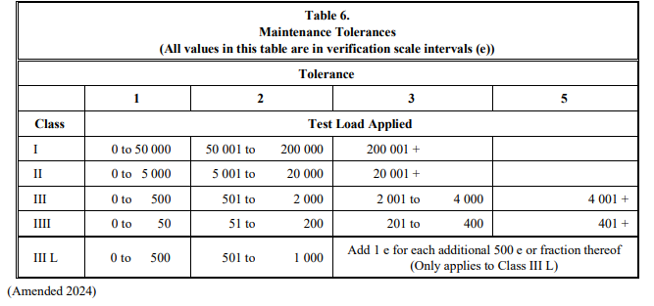
Tolerance
Next, find the specific tolerances value that are applied during the test.
2.20. Scales Code, T.N.3. Tolerance Values
Acceptance Tolerance T.N.3.2 | Maintenance Tolerance T.N.3.1.
The acceptance tolerance values shall be one-half the maintenance tolerance values found in Table 6.

Slide 75
Tolerance
Acceptance tolerance values are one-half the maintenance tolerance values.
0.5
1
1.5
2.5

Slide 76
Verification Scale Interval (e)
How to apply Table 6. during testing. What is a verification scale interval (e)?
Previously all values in Table 6. were in scale divisions (d). Amended 2024

Slide 77
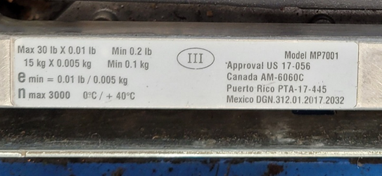
Scale Division (d) and Verification Scale Interval (e)
What is a scale division (d)?
A scale division is expressed in units of weight and is the incremental size between two consecutive indications on a digital indicator or two consecutive marks on an analog indicator. This visual indication is what's called the scales resolution.
What is a verification scale interval (e)?
A verification scale interval (e) is a value also expressed in units of weight and is specified by the manufacturer of the device, by which the tolerance values and accuracy class applicable to the device are determined. The verification scale interval is applied to all scales.

Slide 78
Verification Scale Interval (e)
The test load applied in units of weight must be converted to (e) to determine allowable tolerance.

Slide 79
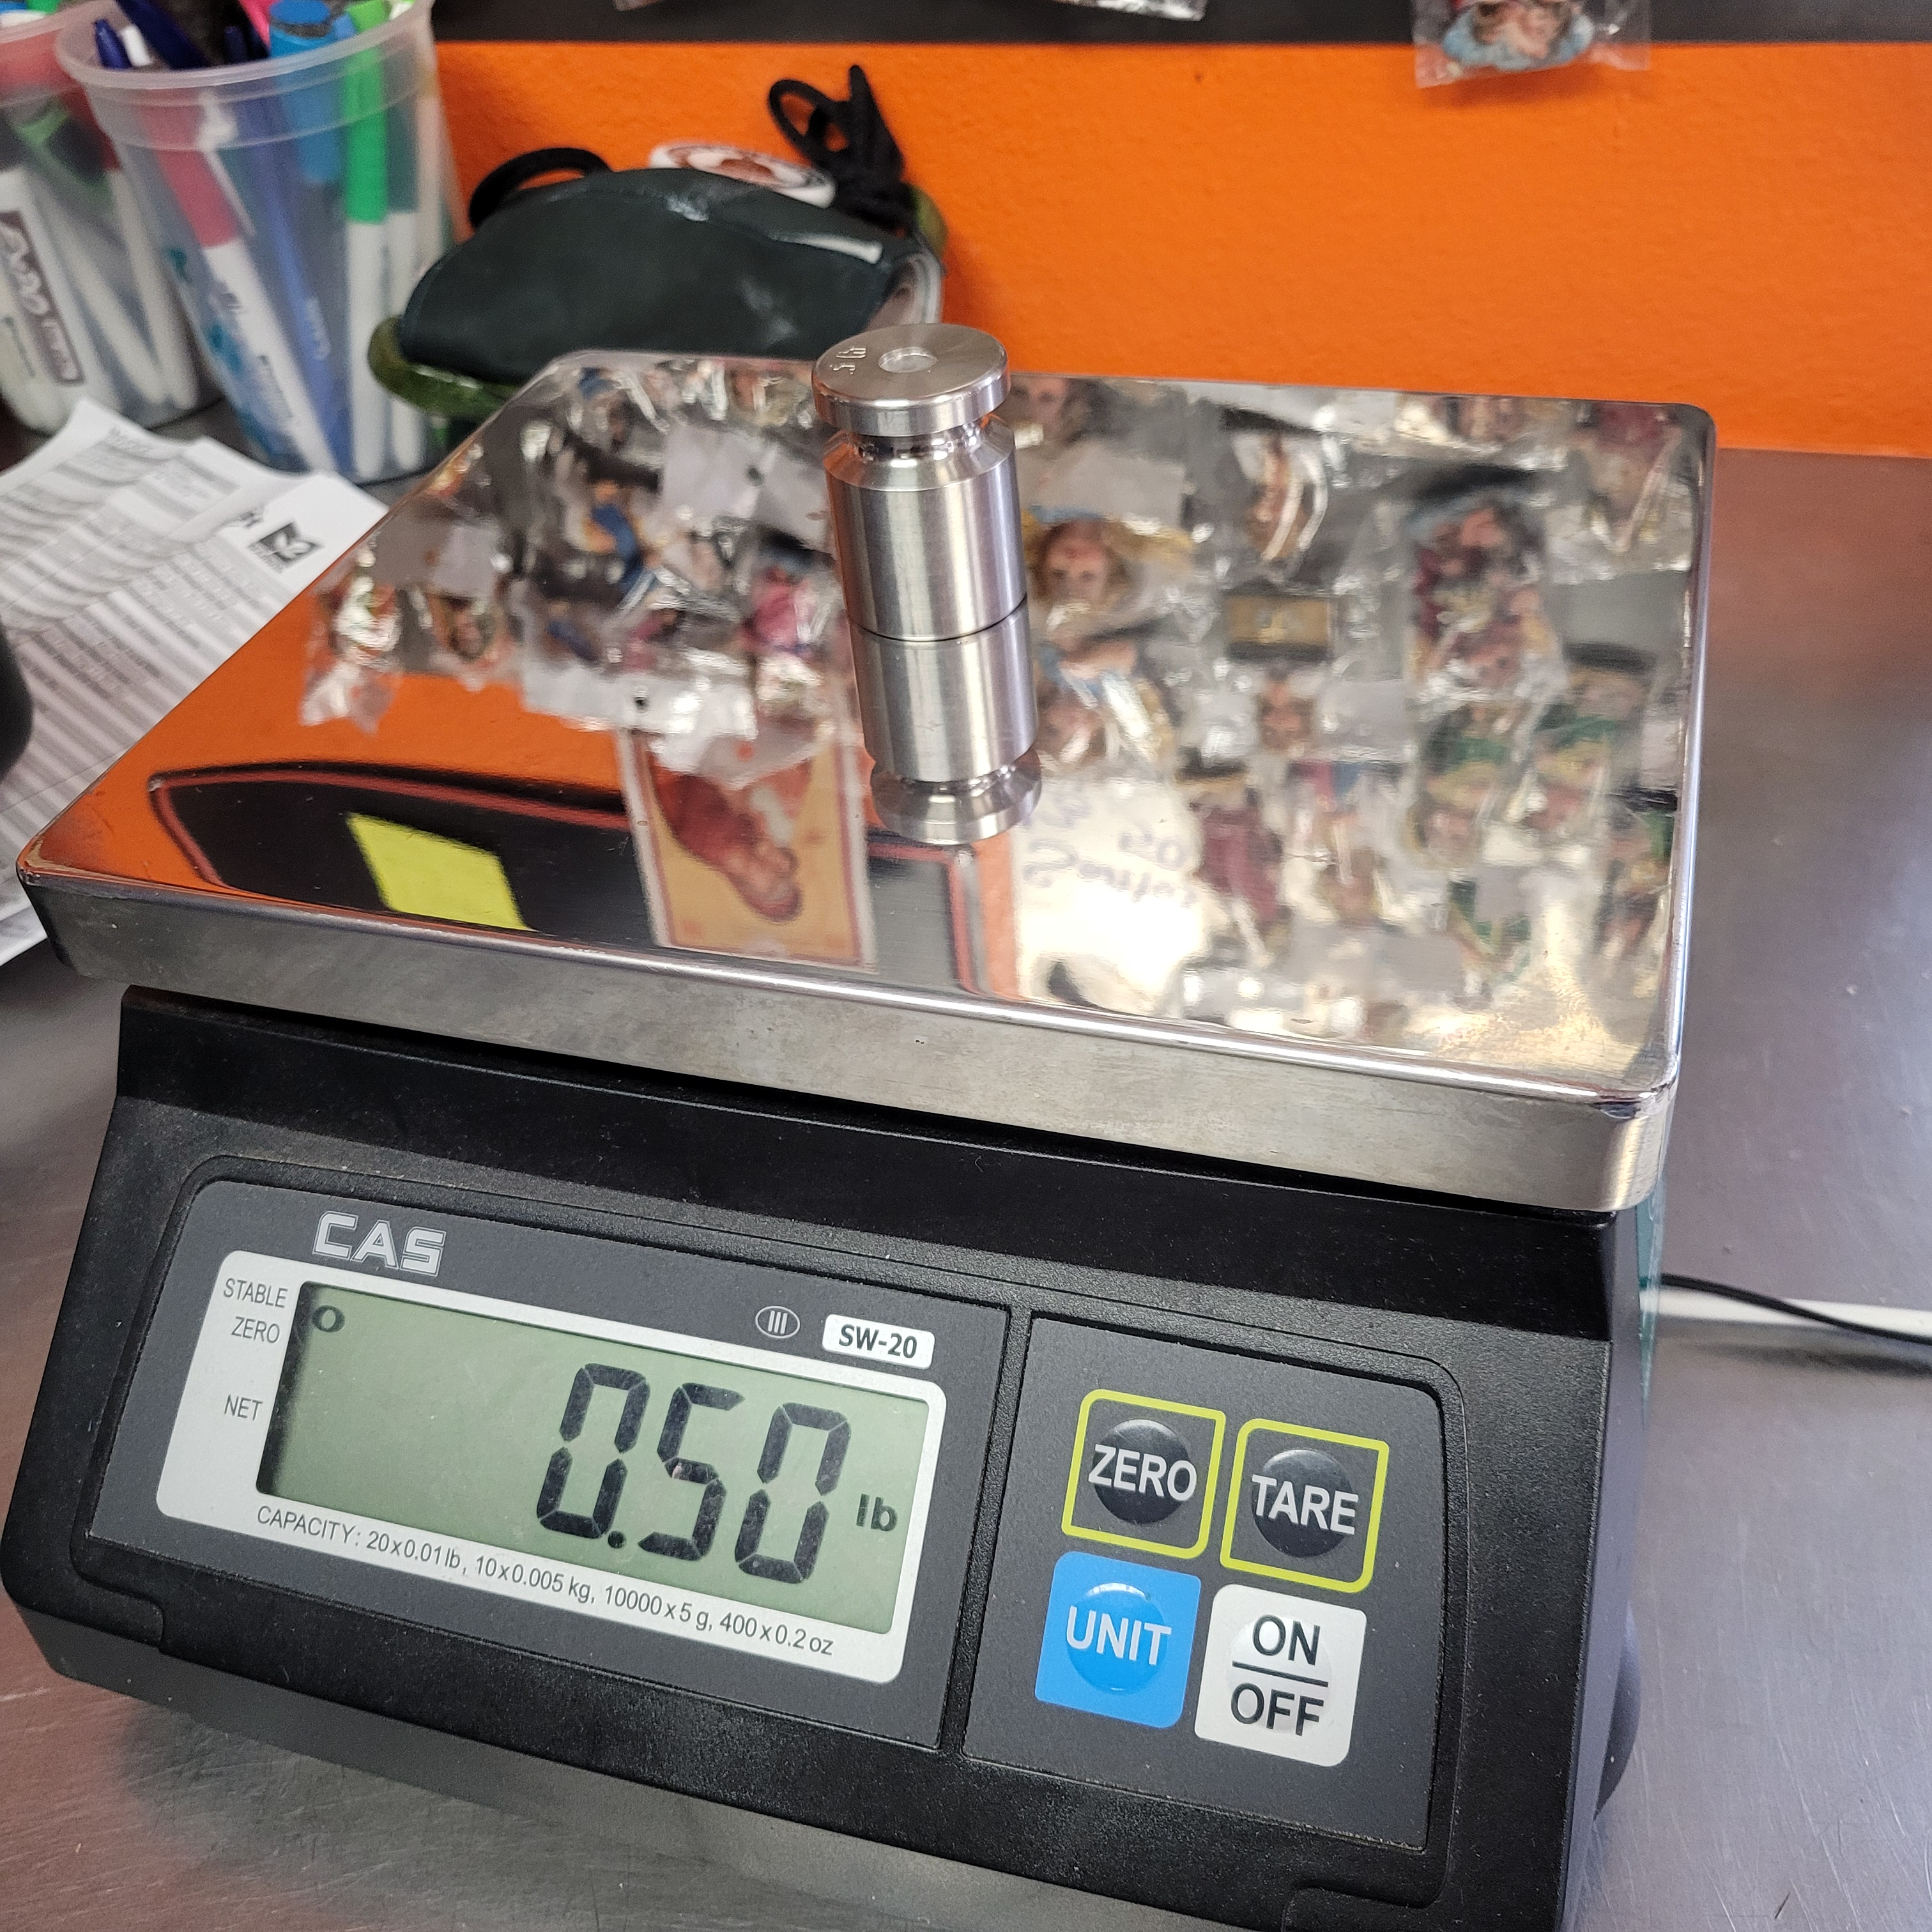
Verification Scale Interval (e)
Answer the following:
What class is this scale?
Convert test load in weight to test load in (e) and determine
tolerance column.
Formula: Test Load in (weight) ÷ (e) = Test Load Applied in (e)
0.50 lbs ÷ 0.01lbs = 50
Class III Where d=e=0.01 lbs

Slide 80
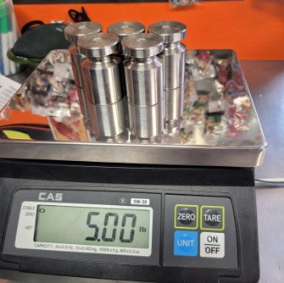
Verification Scale Interval (e)
Answer the following:
What class is this scale?
Convert test load in weight to test load in (e) to determine
tolerance column.
Formula: Test Load in (Weight) ÷ (e) = Test Load in (e)
Class III Where d=e=0.01 lbs

Slide 81
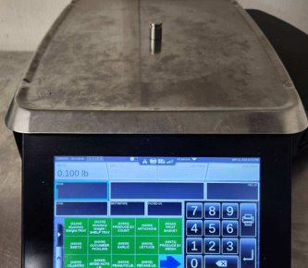
Verification Scale Interval (e)
Answer the following:
What class is this scale?
Convert test load in weight to test load in values of (e) to determine
tolerance column.
Formula: Test Load in (Weight) ÷ (e) = Test Load in (e)
Multi-Interval Class III
1st interval 0-12lbs / d=e=0.005 lbs
2nd Interval 12-30lbs / d=e=0.01 lbs

Slide 82
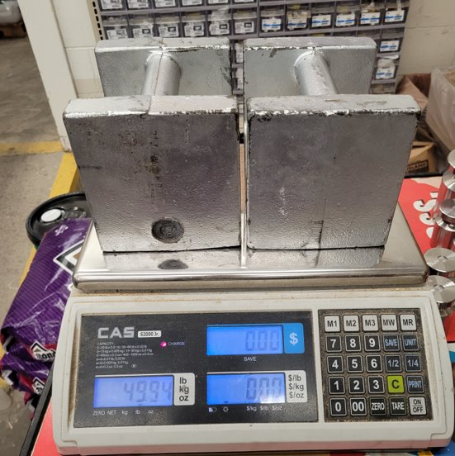
Verification Scale Interval (e)
Answer the following:
What class is this scale?
Convert test load in weight to test load in values of (e) to determine '
tolerance column.
Formula: Test Load in (Weight) ÷ (e) = Test Load in (e)
Multi-Interval Class III
1st Interval 0-30 lbs / d=e=0.01 lbs
2nd Interval 30-60 lbs / d=e=0.02 lbs

Slide 83
Verification Scale Interval (e)
Answer the following:
Does this device comply with Maintenance tolerance?
Acceptance tolerance?
Multi-Interval Class III
1st Interval 0-30 lbs / d=e=0.01 lbs
2nd Interval 30-60 lbs / d=e=0.02 lbs
1.5

Slide 84
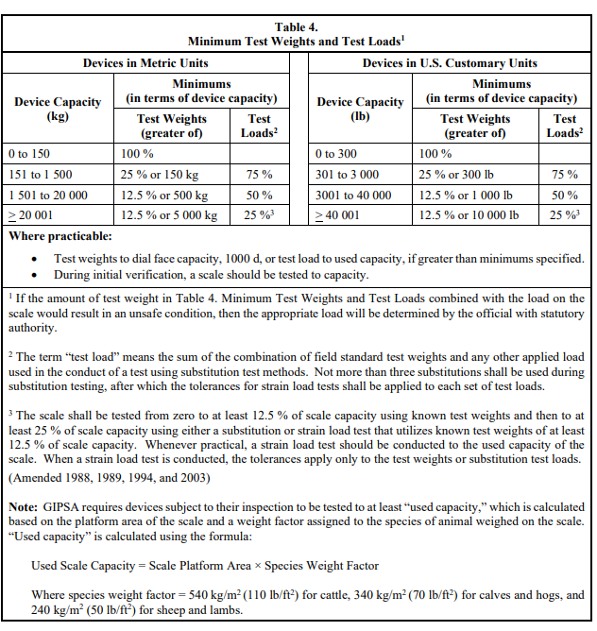
Minimum Test Weights and Test Loads
N.3. Minimum Test Weights and Test Loads. – The minimum test weights and test loads for in-service tests (except railway track scales) are shown in Table 4.

Slide 85
EPO 1 Testing Retail Computing Scales
2026

Slide 86
Test for Electronic Scales
Retail Computing Scales Not Weighing in Metric Units
Increasing Load Test (Center load)
  Begin by checking for discrimination at zero-load balance then checkpoints will be;
        (20d)
        0.50lb
        1lb increments until you reach 5lbs
        1lb, 2lb, or 5lb increments until you reach 30-35% of the scale's capacity
        At 30-35% of the scale's capacity, conduct a shift test
  Shift Test
        T.N.4.4. Shift or Section Tests. – The range of the results obtained during the conduct of a shift test, or a section test shall not exceed the absolute value of the maintenance tolerance applicable, and each test result shall be within applicable tolerances.

Slide 87
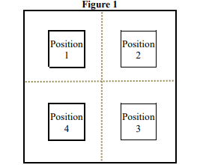
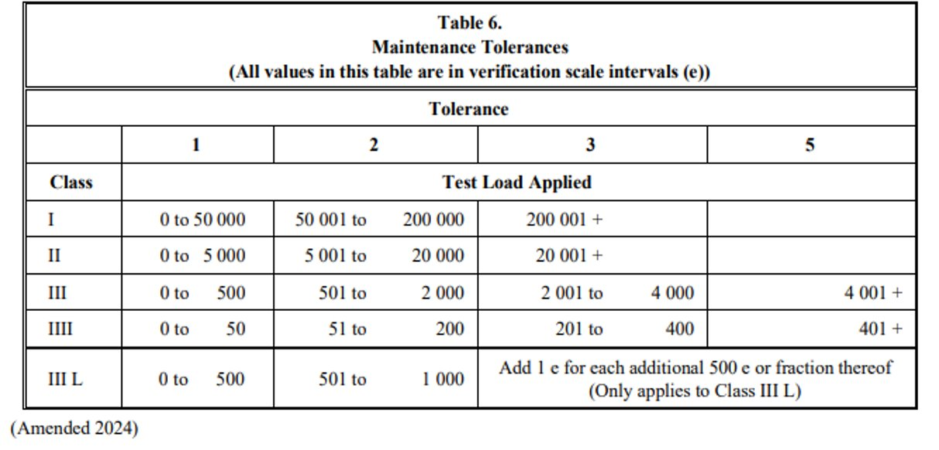
Test for Electronic Scales
Class III Single Interval Scale in Acceptance Tolerance
Occurs at 30-35% of capacity (Example 30lb Capacity)
Each test point must pass applicable tolerance.
Range must comply with maintenace tolerance.
d=e=0.01lbs
How many e values at 10 pounds?
Test Load in (Weight) ÷ (e) = Test Load in (e)
10.00lbs
10.01lbs
9.99lbs
9.99lbs

Slide 88
Test for Electronic Scales
Increasing Load Test continued… (Center load)
After shift test;
        5lb increments until you reach capacity
        During increasing load test, include check points equal to 500d, 2000d, 4000d
        Test for over-capacity
          See Code: 2.20: S.1.7.(a), S.1.7.(b)
        Check for RFI/EMI if problem suspected

Slide 89
Test for Electronic Scales
Decreasing Load Test (Load Centered)
After testing for over-capacity;
        if the scale has 1000 or more scale divisions, test with loads equal to the maximum test load at each tolerance value.
        All other scales test with one-half of the maximum test load applied in the increasing load test.
Example: for a Class III scale with 3000 scale divisions and 0.01 scale division test at 3000d, 2000d, 500d. Checkpoints on decreasing load test will be 30lbs, 20lbs, and 5lbs.
        Recheck zero-load balance
Reapply a physical security seal if calibration was performed and a physical seal is required.

Slide 90
Other Information
Arkansas Bureau of Standards may soon require RSA certification on
NIST Handbook 44 Scales Requirements
Certification exam is available on the National Council on Weights and Measures (NCWM) website and will be recognized by this state.

Slide 91
Summary
Our follow up goal is to quickly determine compliance and exit.
Affix Seals and Decals properly. No stacking decals.
Leave a copy of Test Report at the site.
Email one copy to Bureau@agriculture.arkansas.gov within two weeks
Once the reports are signed you could be held accountable for any issues at the site.
Do not work in the State if your Registration has expired. Renew before it expires.
-Extension on Registration will not be granted if your Registration has expired
-If your calibration certification date is over six-months-old, you may not apply for registration with our office
We require your cooperation in correcting nonconformities in expediting manner.
Your work represents our office and the State of Arkansas.

